Slide 1
PICTURE TO PATCH TRANSLATION

Slide 2
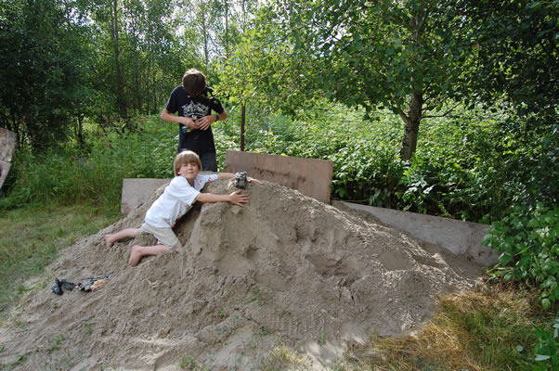

Slide 4
BASIC RULES
Make the drawing the same size as the finished patch.
Insert parallel line 1/8 inch inside outline before doing anything else. (Allows for border.)
Don’t make lettering too small. Try Helvetica Bold Outline, (no smaller than 16 point)
If it’s too small to draw with a colored pencil or a nylon tip marker, it can’t be stitched with a needle and thread.

Slide 5
Cartooning

Slide 6
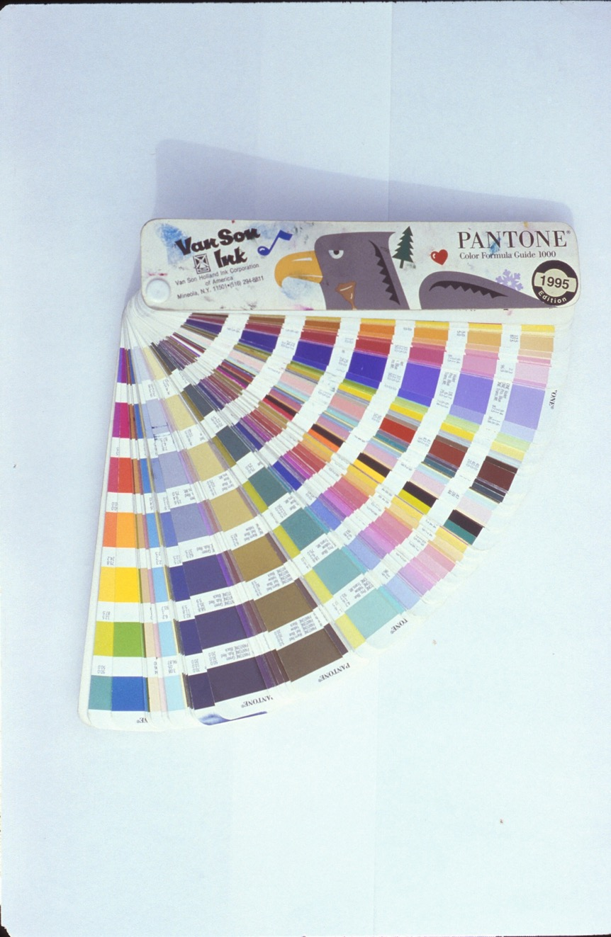

Slide 7
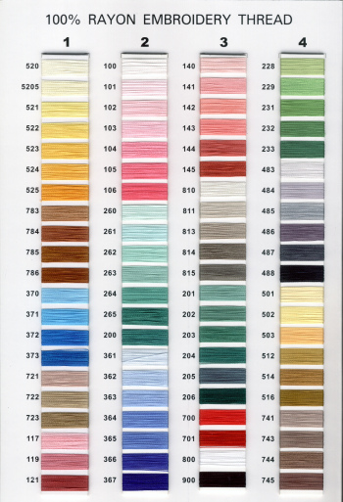
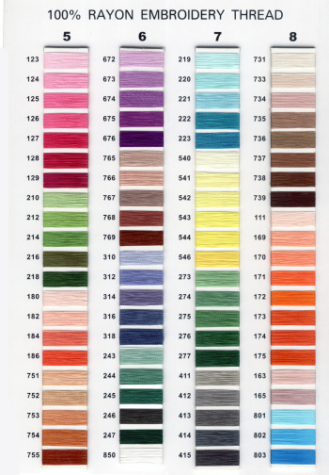
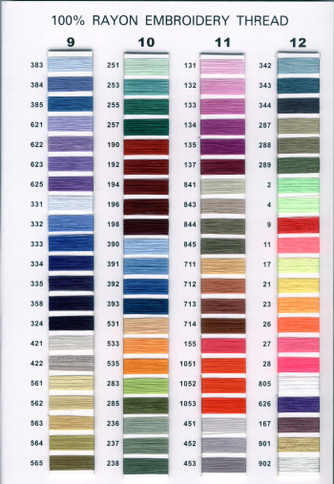

Slide 8
THREAD COLOR
RESOURCES
www.gopatch.com

Slide 9
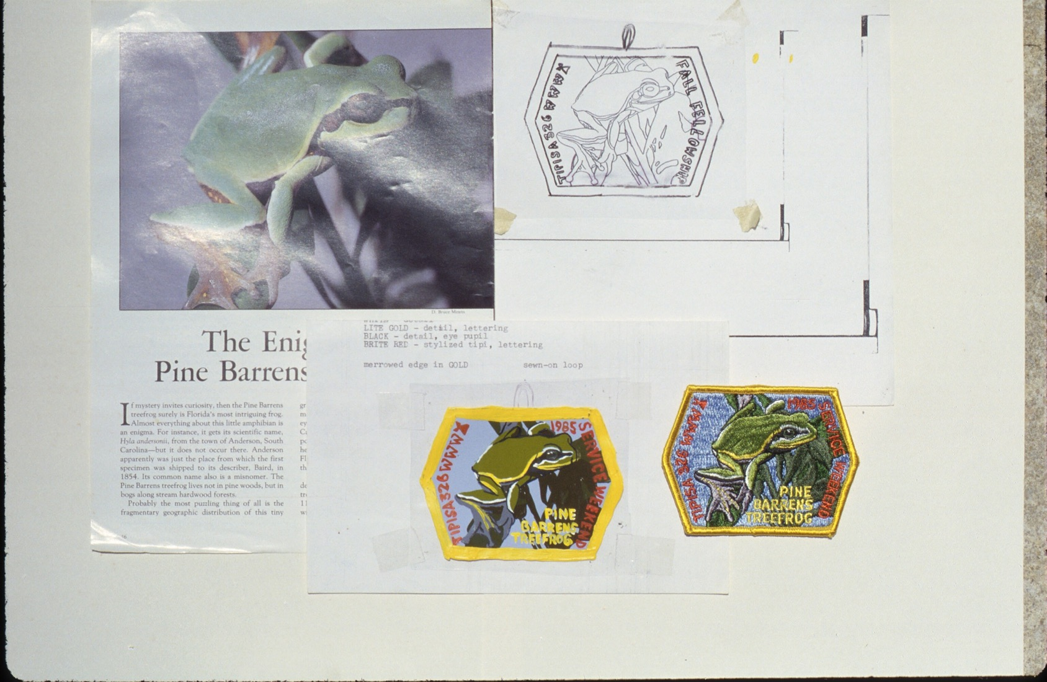

Slide 11
What color is Water?

Slide 12
What color is a blue sky?

Slide 13
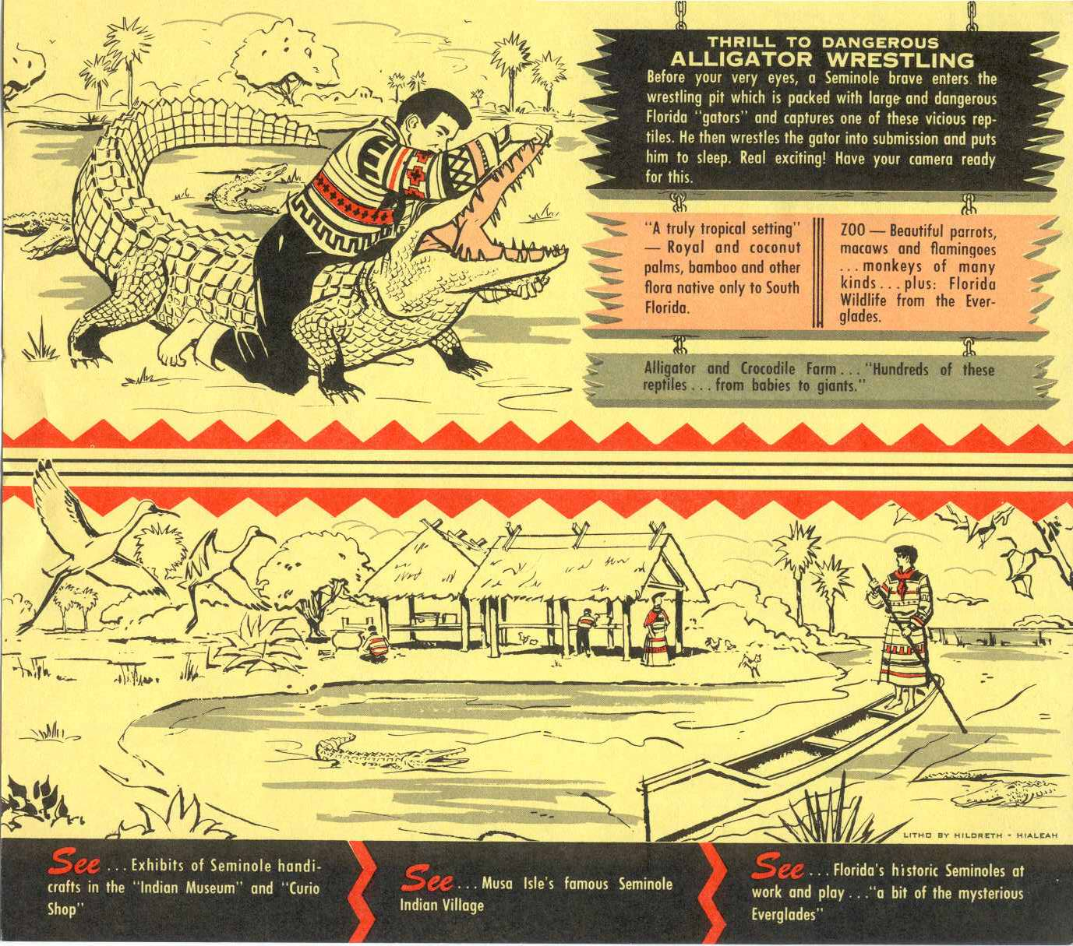

Slide 14
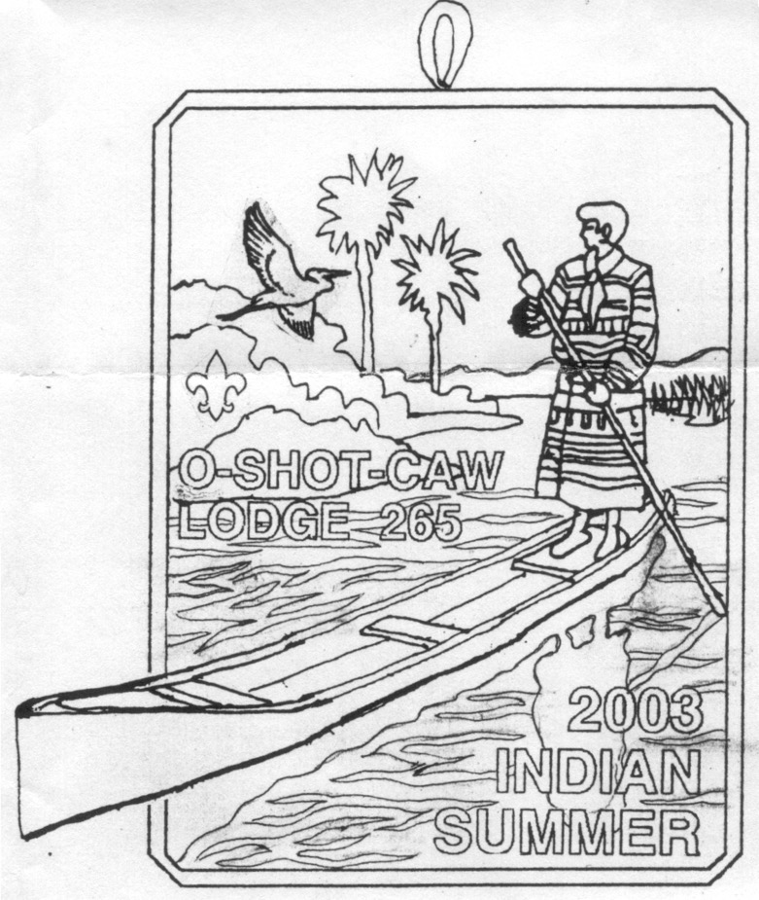

Slide 15
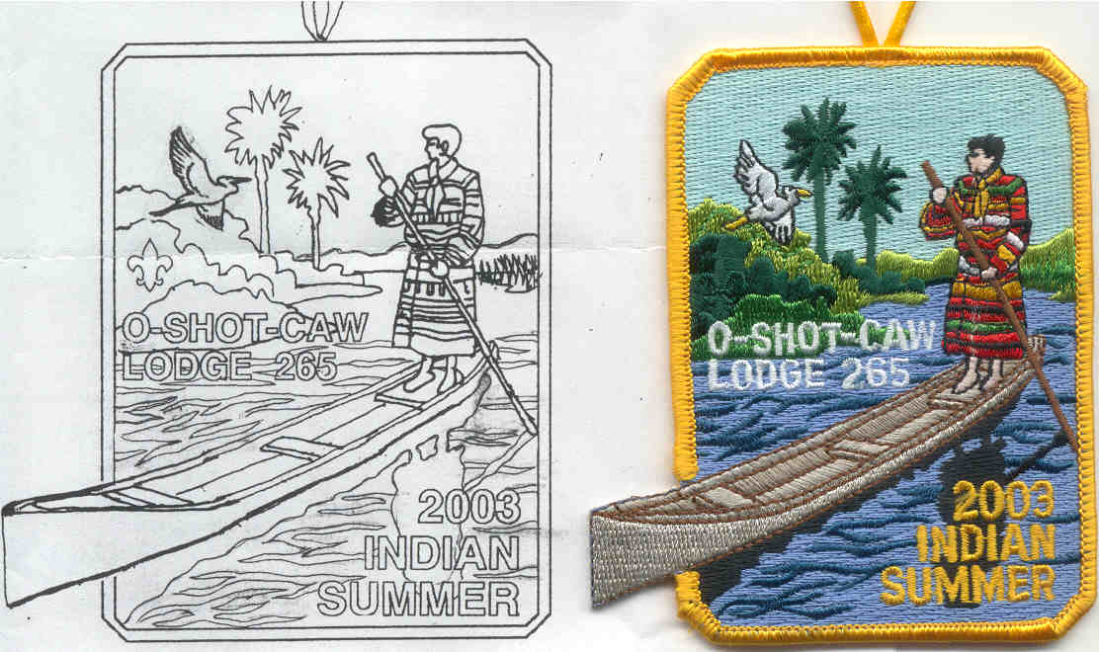

Slide 16
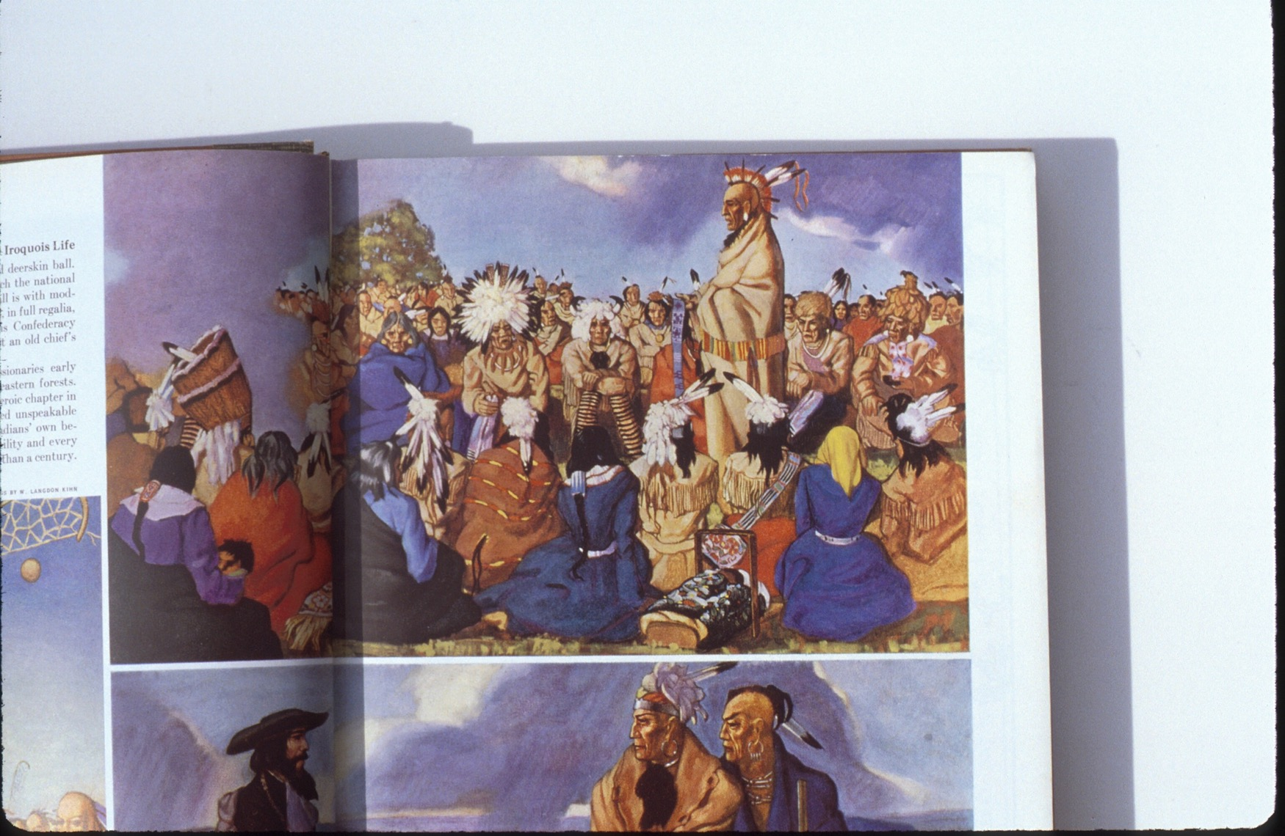

Slide 18
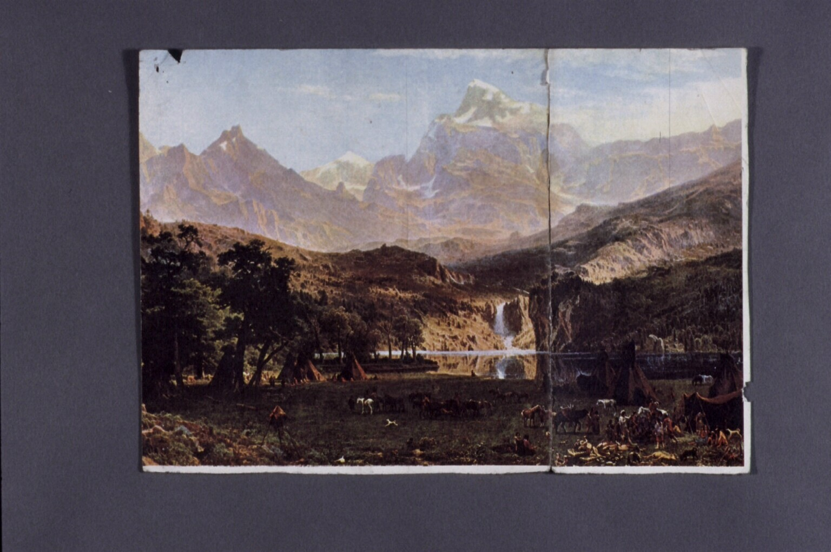

Slide 19
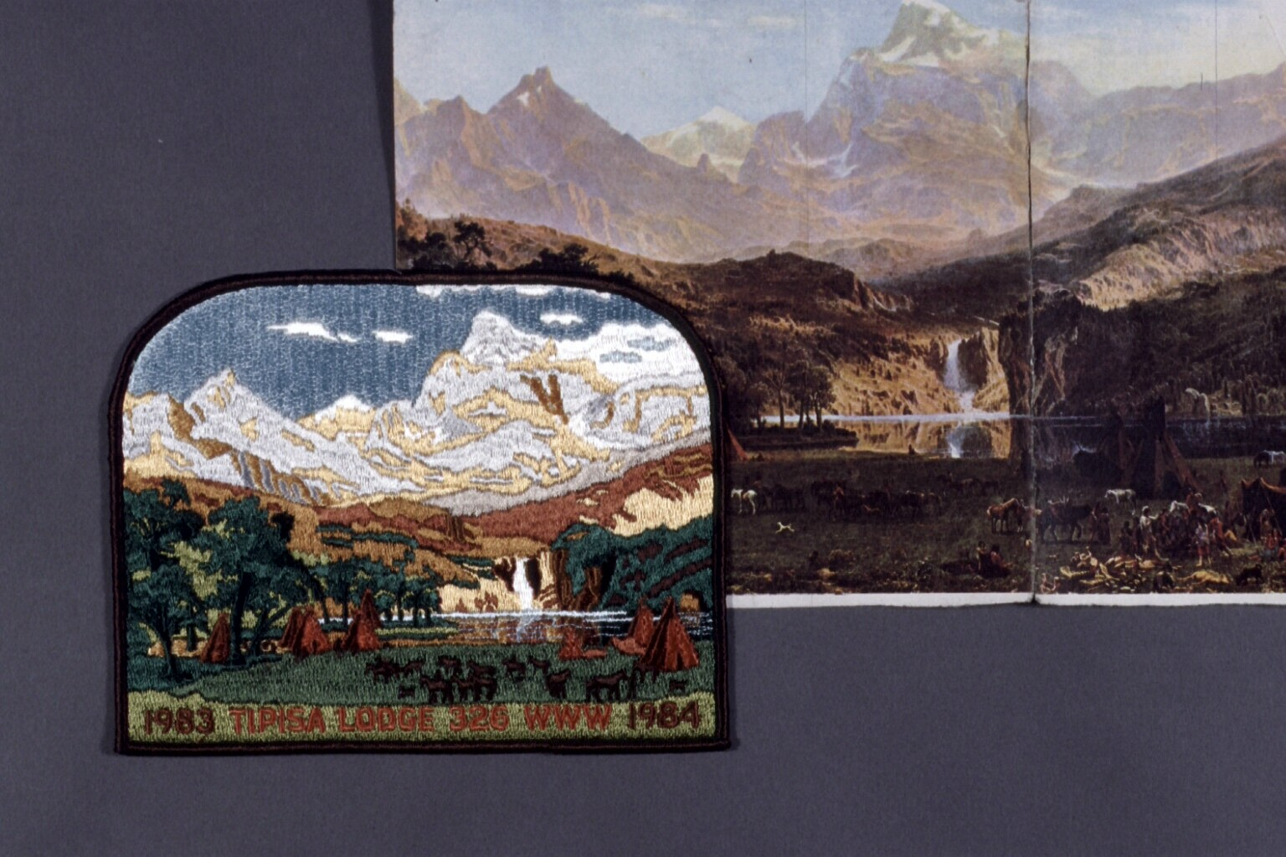

Slide 24
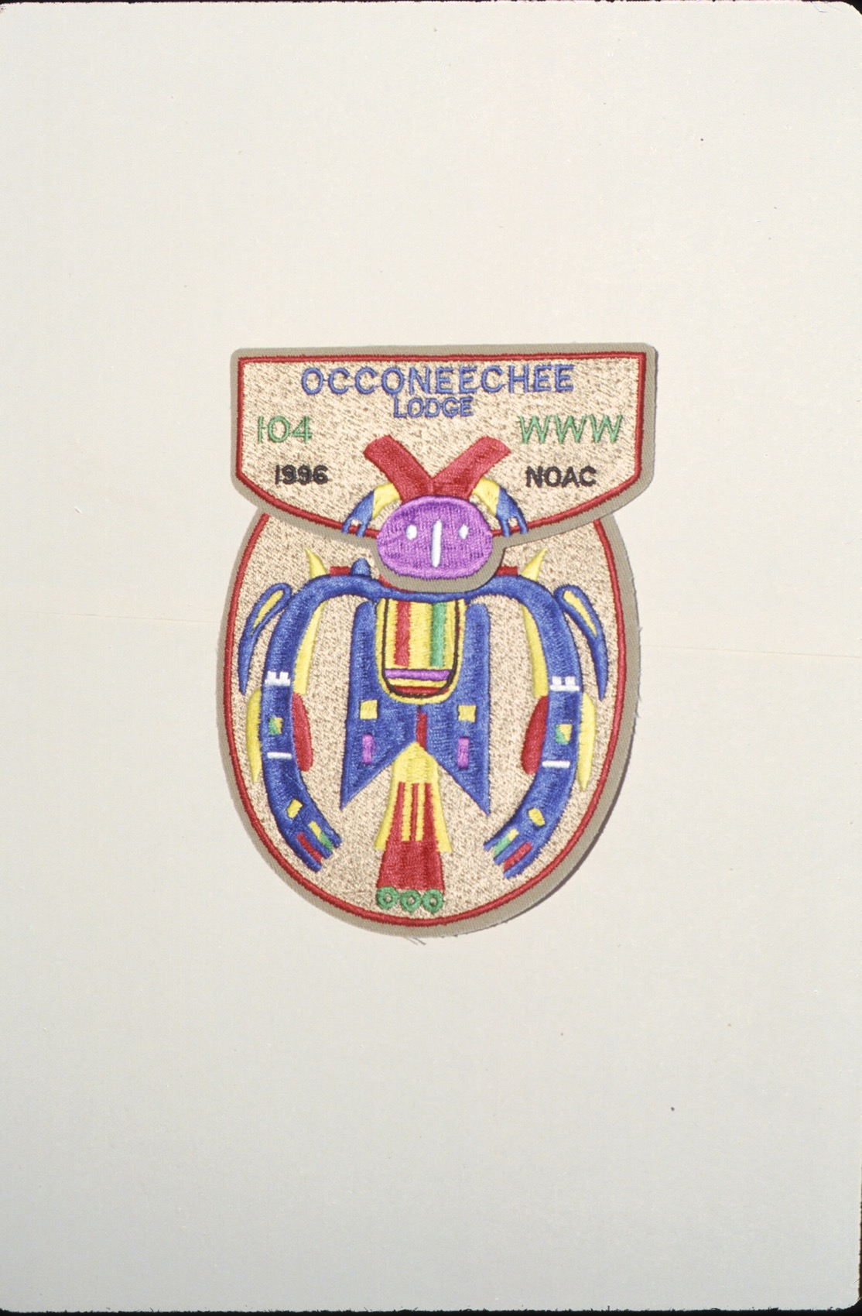

Slide 25
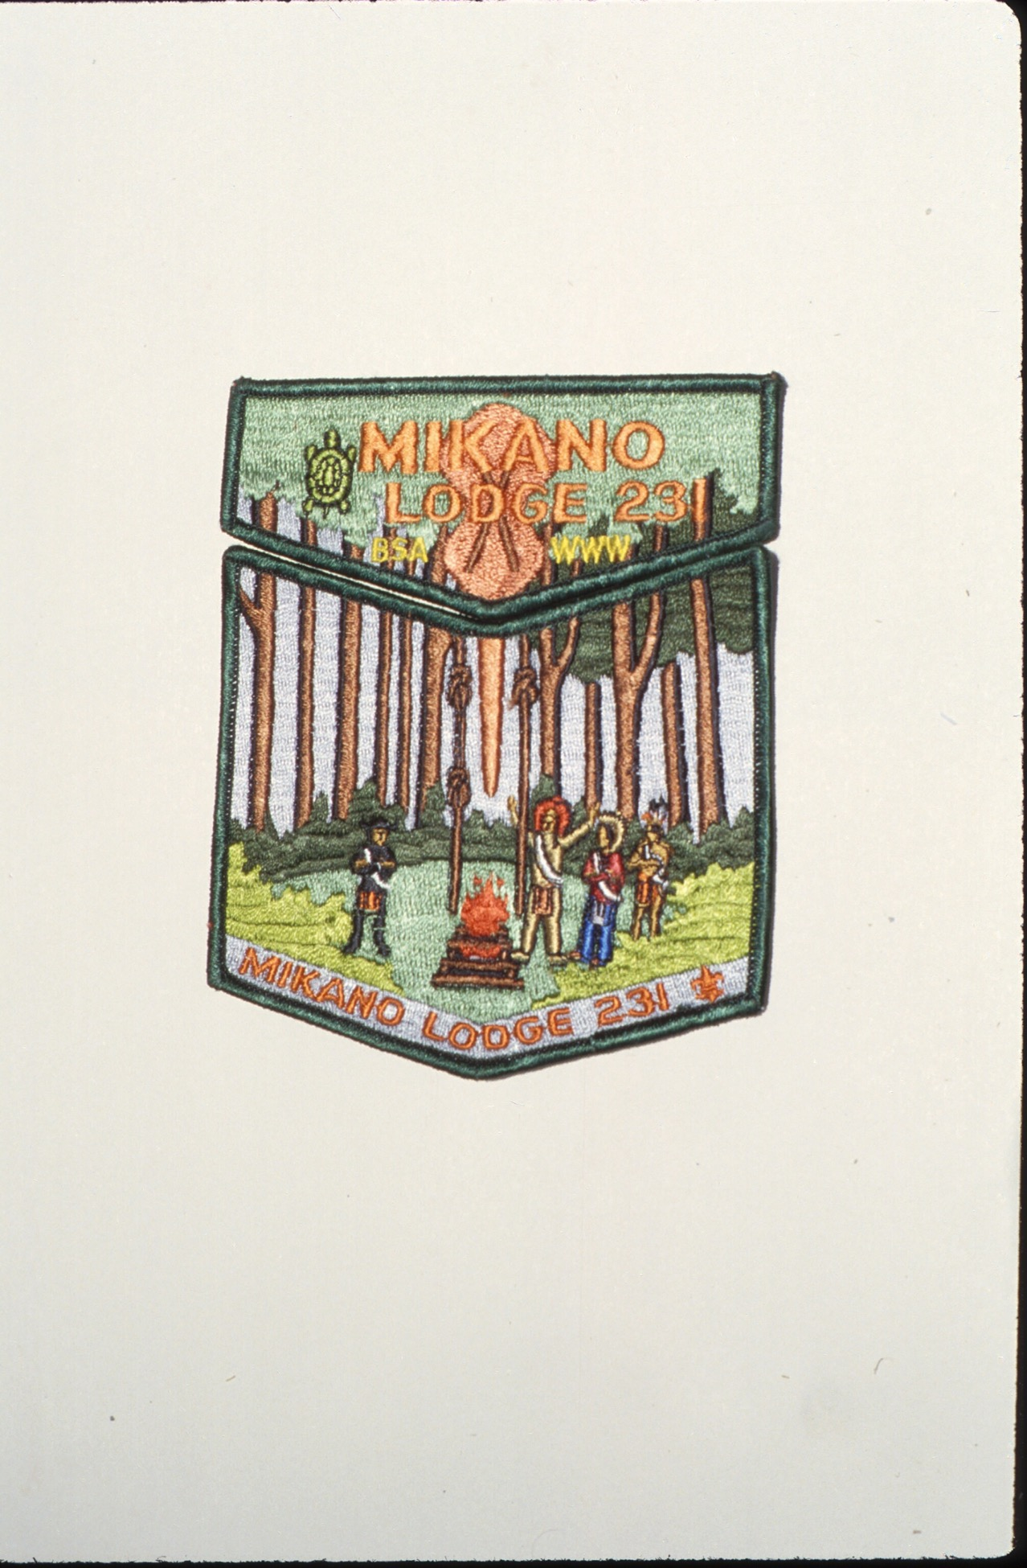

Slide 26
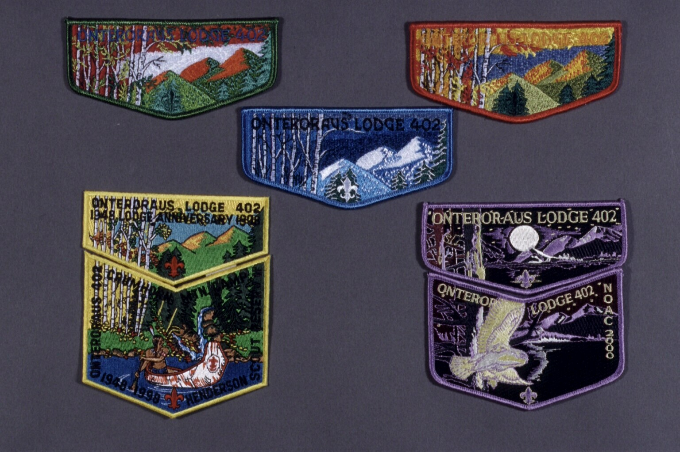

Slide 27
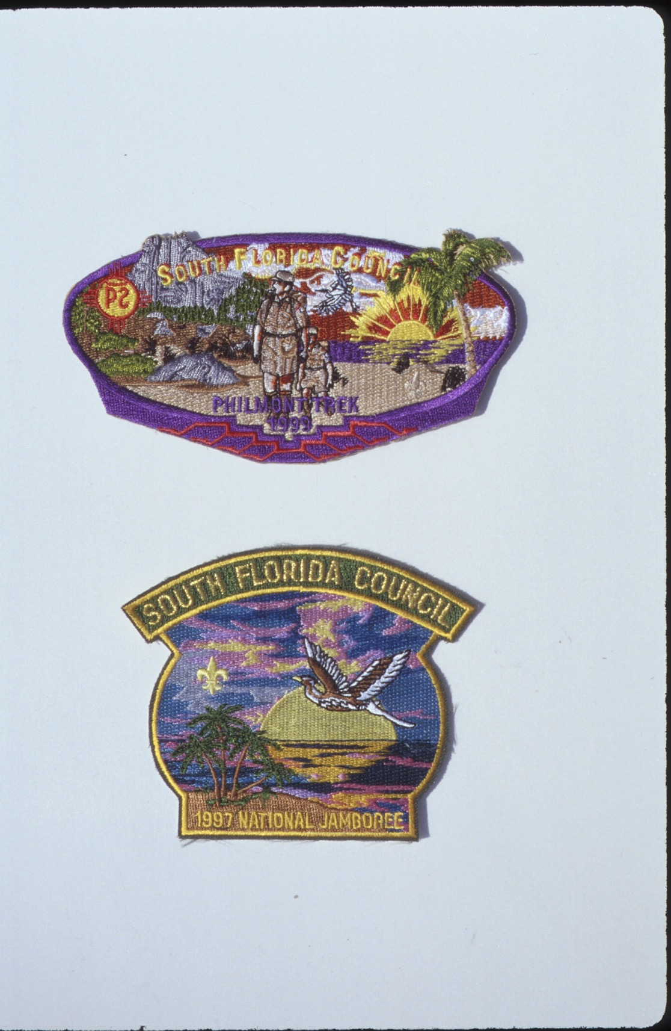

Slide 29
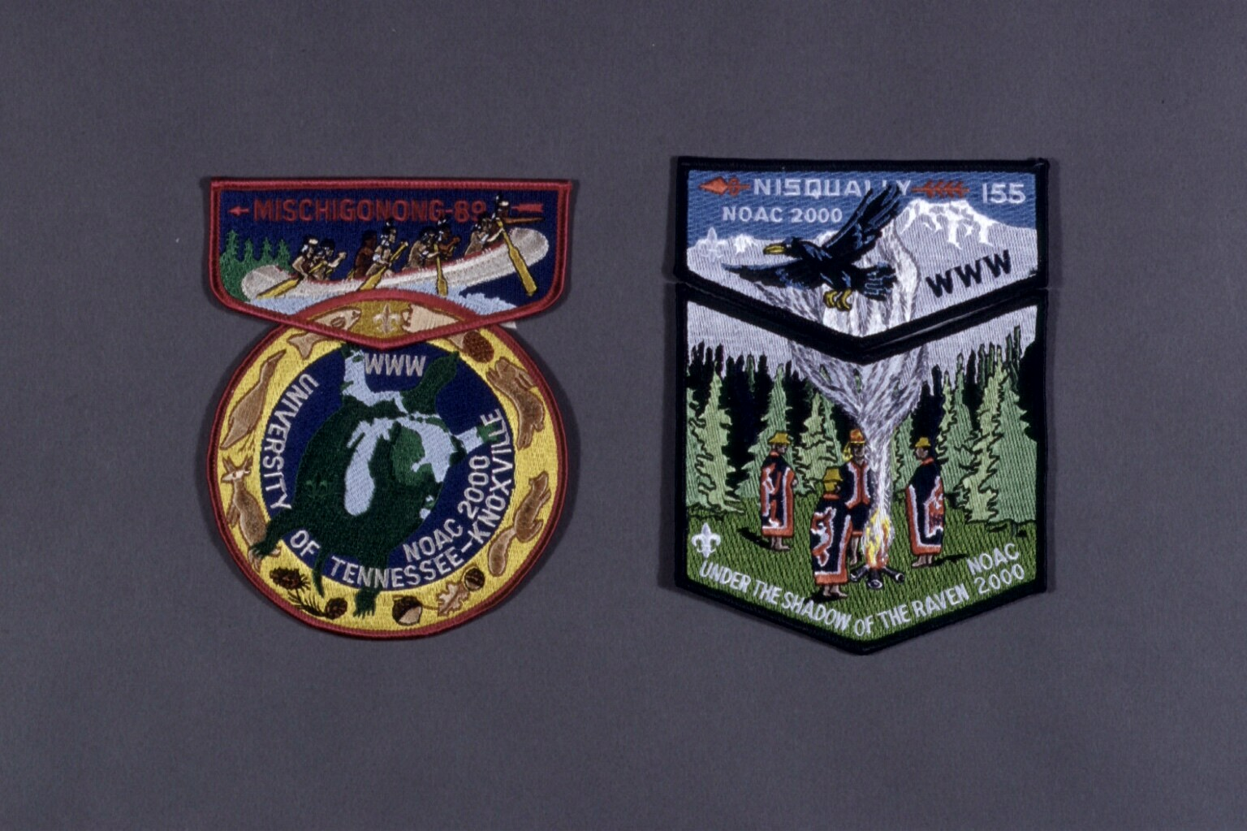

Slide 30
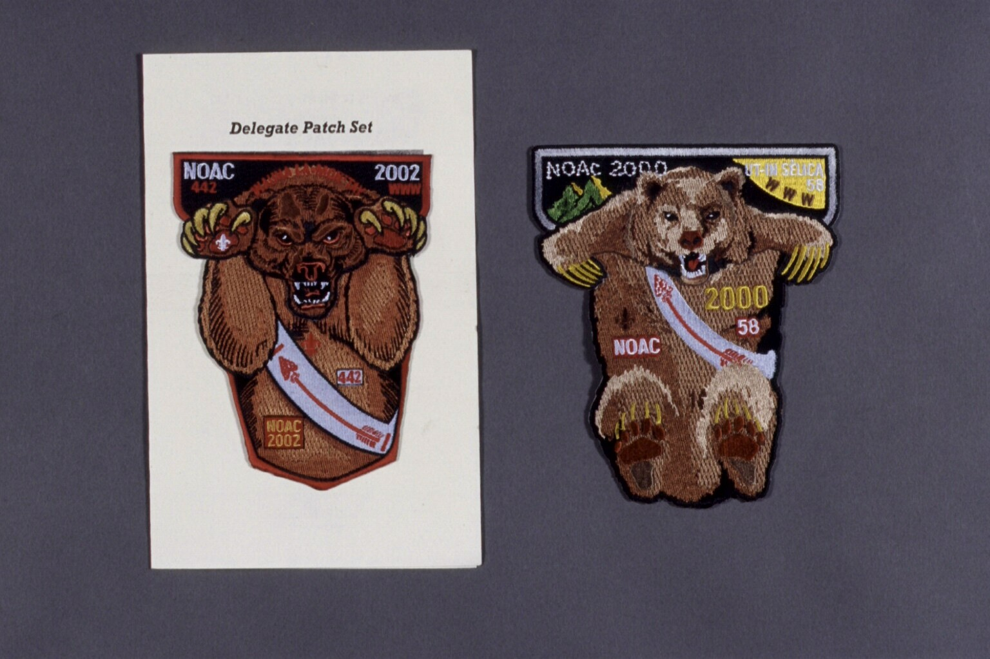

Slide 31
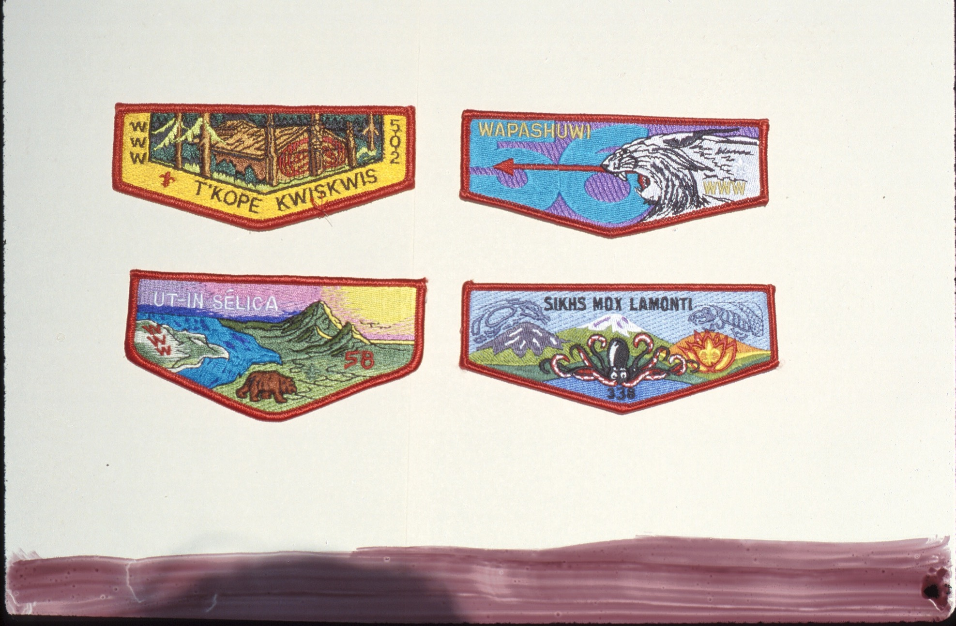

Slide 32
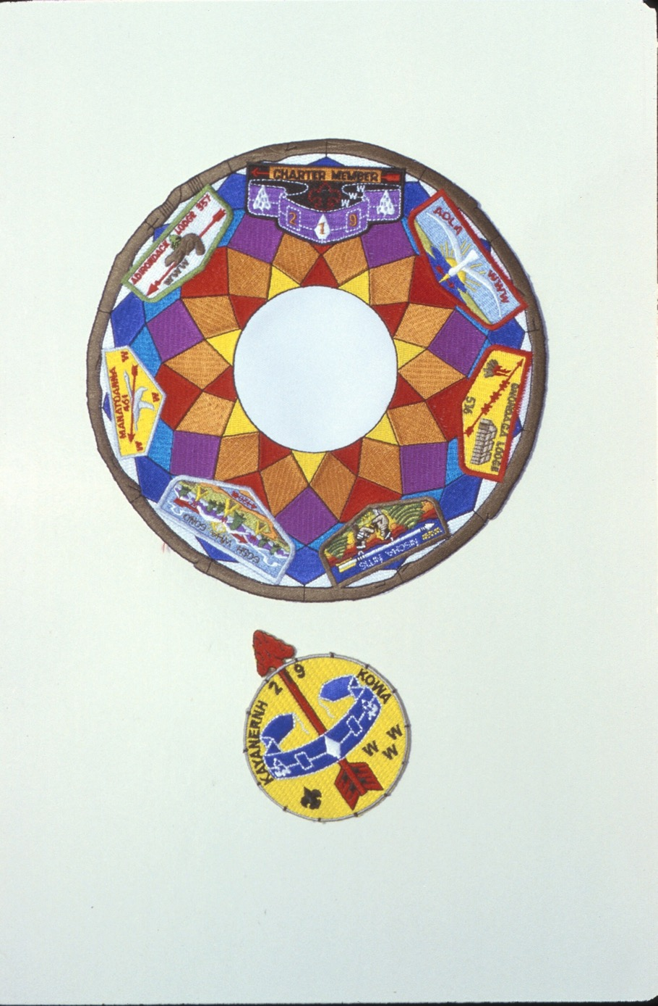

Slide 33
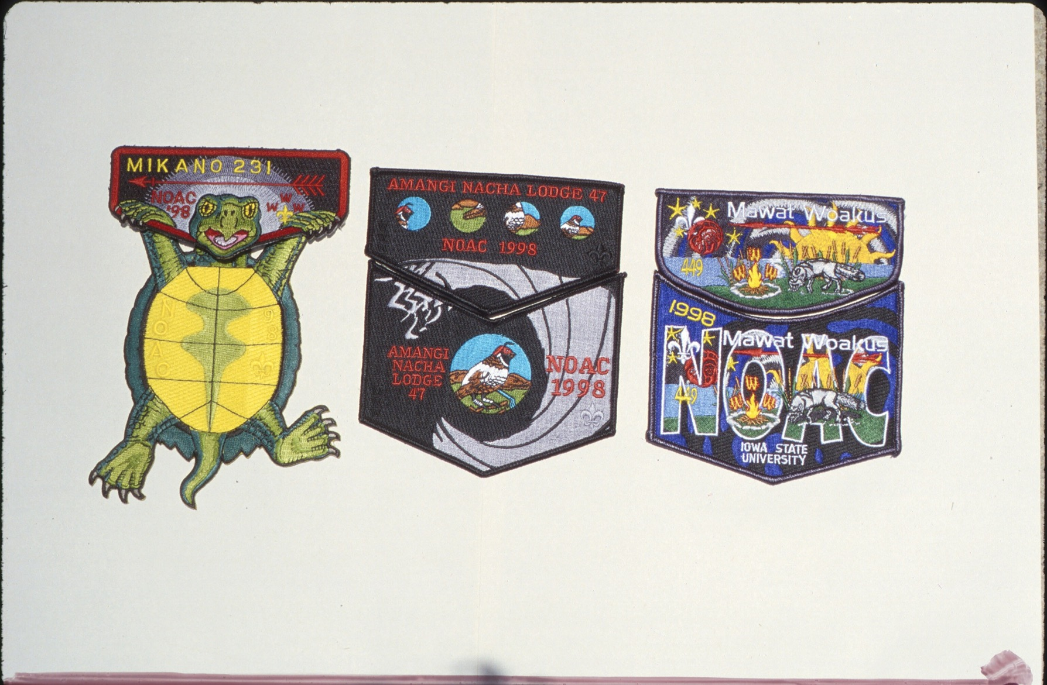

Slide 34
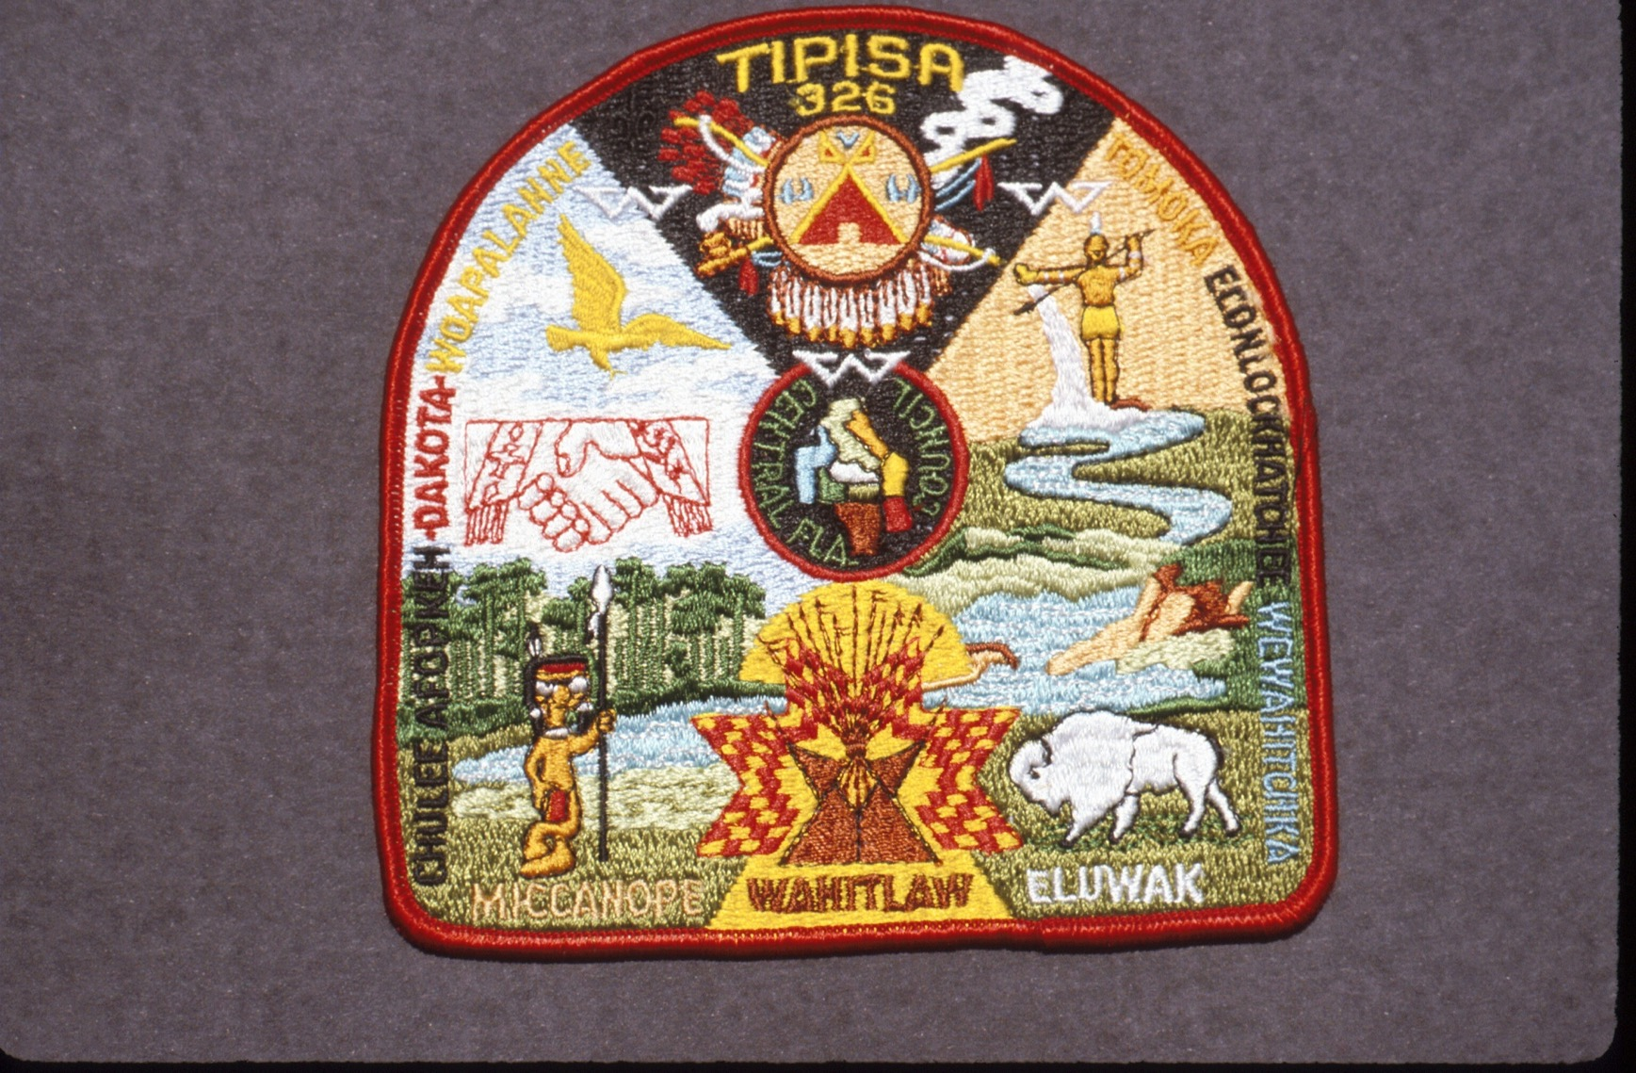

Slide 35
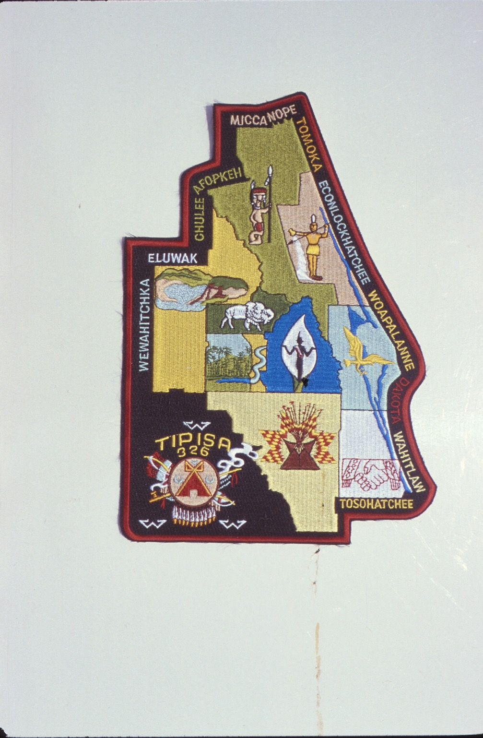

Slide 36
For Training Resources and More Information Visit:
http://training.oa-bsa.org/noac2015

