Slide 1
Notes:
http://blog.teambuildevents.co.uk/2012/11/26/team-motivation-art-for-your-office/

Slide 2
Motivating the Team

Slide 3
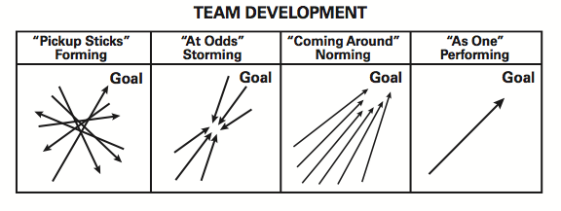
Notes:
Wood Badge 2015 Syllabus

Slide 4
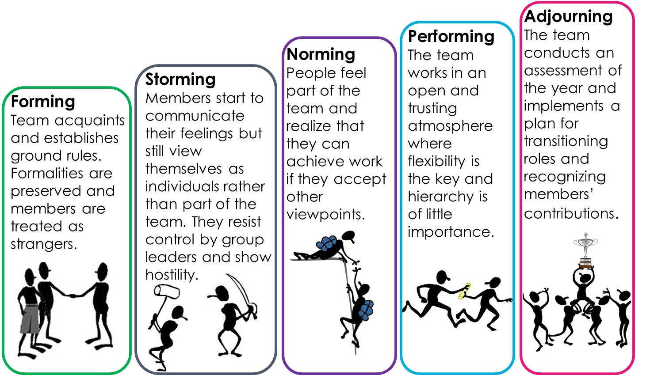
Bruce Tuckman’s Model of Team Development

Slide 5
Forming
Behaviors
Tasks
Making contact and bonding
Developing a trust
Members dependent
Establish base level expectations
Identify similarities
Agreeing on common goals
www.lumaxart.com/

Slide 6
Storming
Behaviors
Tasks
Expressing differences in ideas, feelings, and opinions
Each competing for consideration
Reacting to leadership
Team members expressing independence
Identifying power and control issues
Sharing opinions and views
Identifying resources
www.lumaxart.com/

Slide 7
Norming
Behaviors
Tasks
Single goal established
Decisions made through negotiation and consensus building
Agreement about roles and processes for problem solving
Members take responsibility to work for success
www.lumaxart.com/

Slide 8
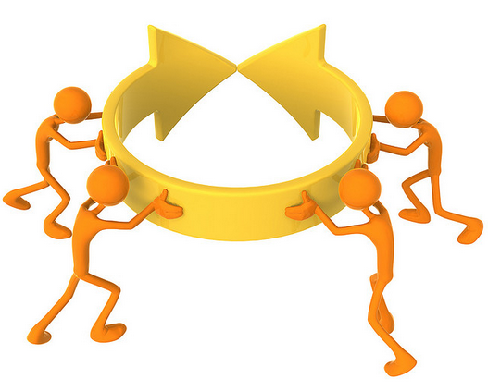
Performing
Behaviors
Tasks
Members work collaboratively
Members care about each other
Group establishes unique identity
Members are interdependent
Achieve effective and satisfying results
Members find solutions to problems appropriately
www.lumaxart.com/

Slide 9
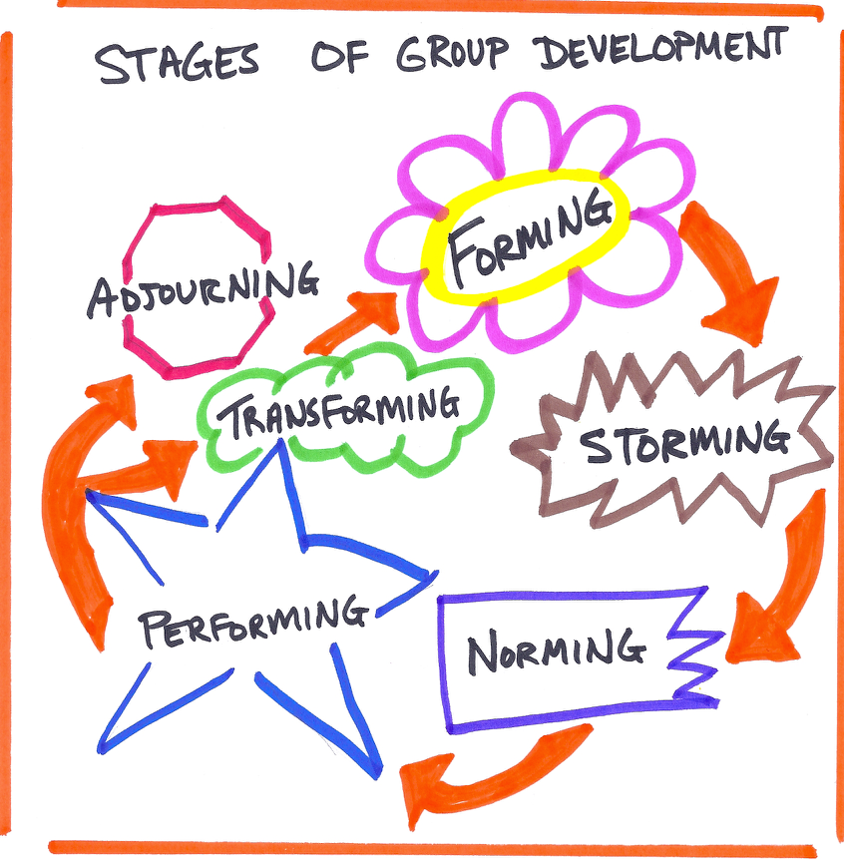

Slide 10
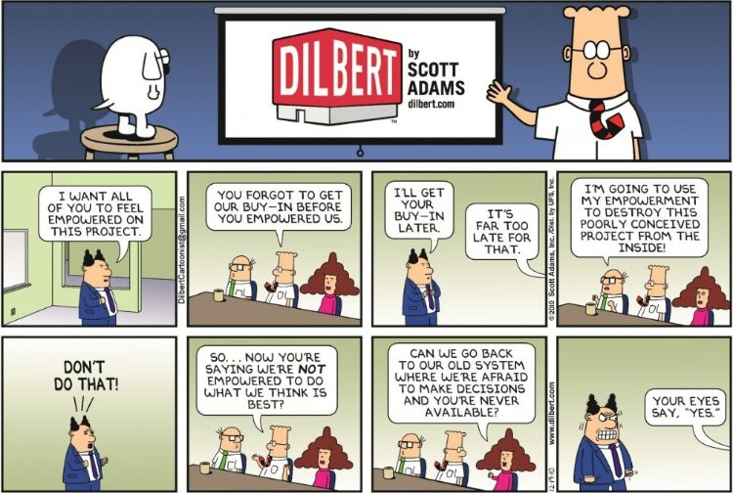
Empowering
Notes:
https://www.linkedin.com/pulse/20140715135947-38109935-empowering-teams

Slide 11
For Training Resources and More Information Visit:
http://training.oa-bsa.org/noac2015

