Slide 1
A+ Alumni Relations
Reconnecting with alumni,
Rekindling their enthusiasm with Scouting, and Re-engaging them in the Program.

Slide 2
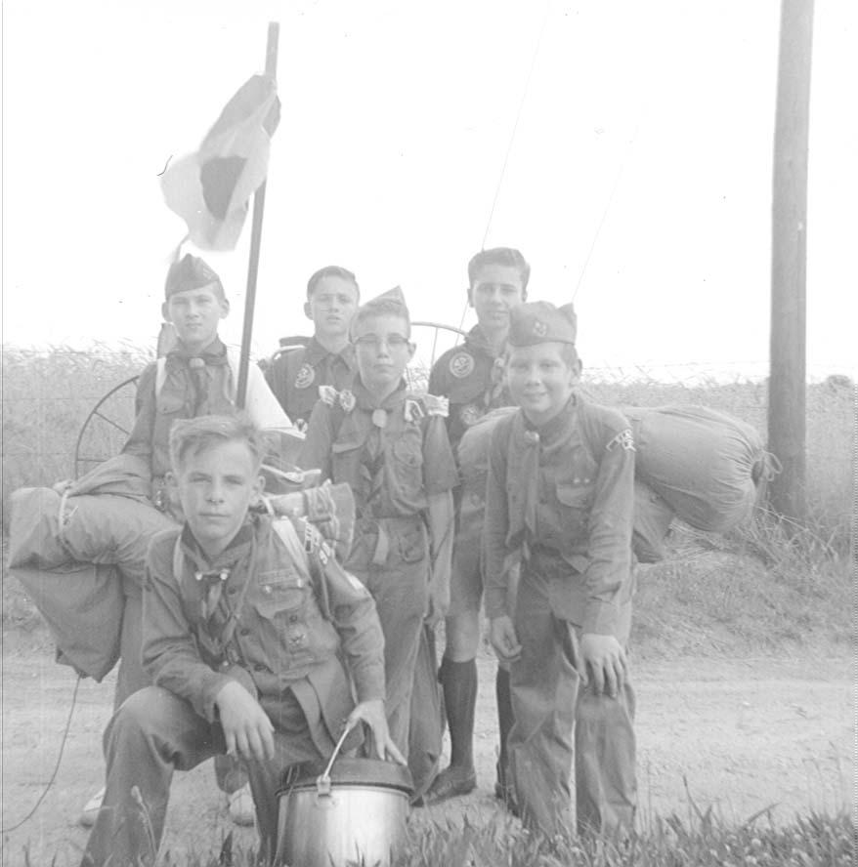
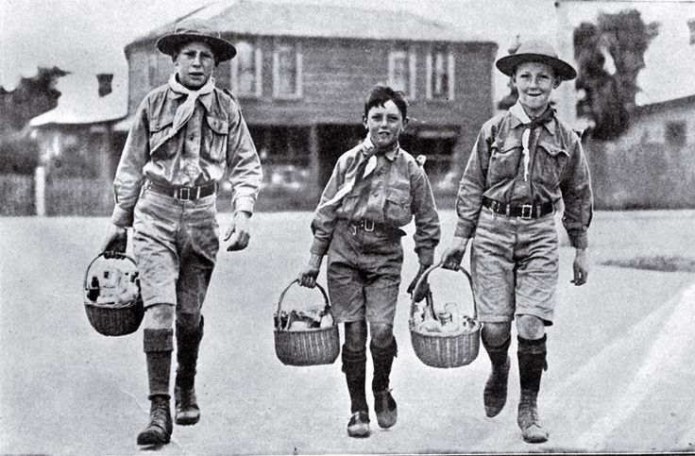
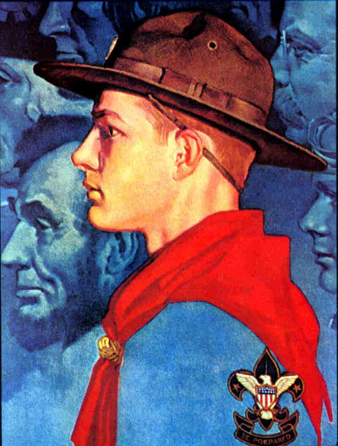
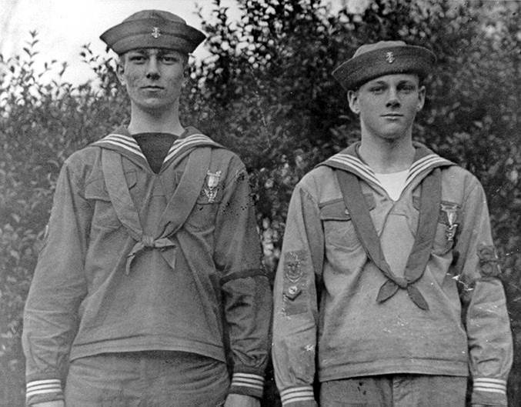
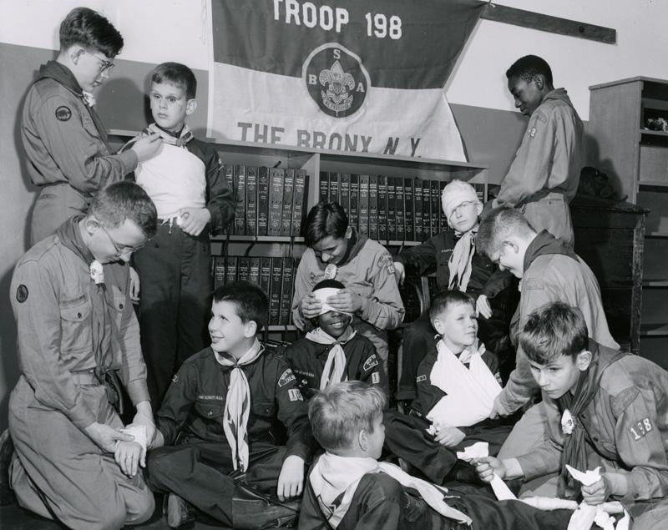
What is an alumnus?

Slide 3
Opening Activity
Ice Breaker
Please take 8 minutes to pair up with someone that you do not know and introduce yourself to them. During this process, get to know them and answer the questions below.
We will get back together and you will introduce this person to the group and share this information with the group.
Who I met: ______________________________________________
What are 2 interesting facts outside of scouting that you have learned?
1.
2.
What are 2 interesting facts related to scouting that you have learned?
1.
2.

Slide 4
Why are Alumni Important?
of registered adult leaders are alumni
?%

Slide 5
Benefits
Diversifying Lodge Program
Help complement the program with experience
Networking
Offer intricate professional connections
Mentoring
Jumpstart young Arrowmen’s careers

Slide 6
Reconnecting with Alumni
Alumni website: www.scoutingalumni.org/
E-mails and Texts
Harris Connect Search
Online Groups/Pages (Facebook, LinkedIn, etc.)
Facebook Advertising
Newspapers/Newsletters
Word-of-mouth

Slide 7
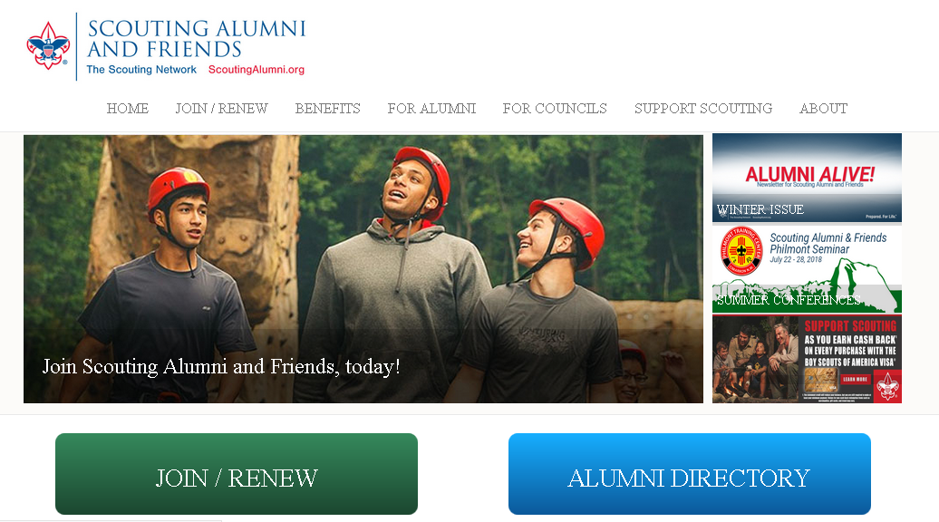
Alumni Website

Slide 8
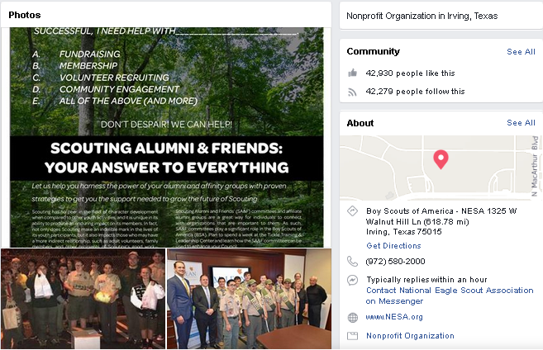
Facebook Page

Slide 9
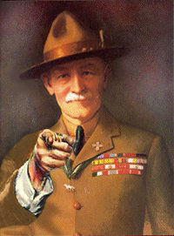
The best method:
YOU are the best method of communicating Scouting.

Slide 10
Re-kindle Their Enthusiasm
4 Key Attributes:
Personal outreach
Low cost
Low commitment
Gradual steps

Slide 11
Activity
Event options:
Pizza party at camp
Dinner reception
Trade-based reception

Slide 12
M&M Method
Memories
Marketing
Membership
Manpower
Money

Slide 13
Re-engage Them Back
Position
vs.
Non-Committal
vs.
Monetary

Slide 14
Thanks for joining us today!
Any questions?

