Slide 1
Unit Relations A Guide to Effective Local Program

Slide 2
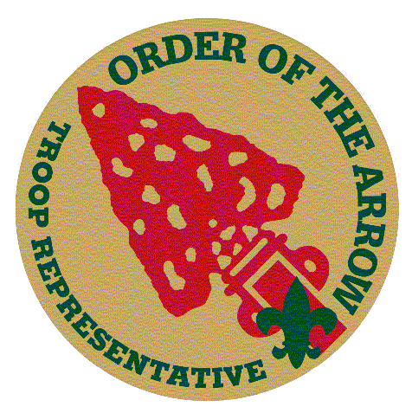
OA Unit Rep Background
Created in 1999
First time in the history of the BSA that the Order of the Arrow had a formal role in unit operations
Official unit leadership position that counts towards rank advancement
Also a role for an adult Arrowman in the unit to serve as the Representative’s adviser

Slide 3
OA Unit Representative
What are some tasks that the OA Unit Representative might perform?

Slide 4
OA Rep Position
Qualifications
Under 18 years old
Appointed by SPL with Unit Leader approval
OA Member in good standing
OA Unit Rep reports to:
Assistant Senior Patrol Leader
Rank Advancement
While a First Class Scout*, serve actively for 4 months in one or more of the following positions of responsibility:
Patrol Leader, assistant senior patrol leader, senior patrol leader, troop guide, Order of the Arrow troop representative, den chief, scribe, librarian, historian, quartermaster, bugler, junior assistant Scoutmaster, chaplain aide, or instructor.
* Star and Life Scout requires 6 months of service

Slide 5
Organization
Lodge/
Chapter Chief
Vice Chief
OA Unit
Representative
Chairman
Liaison
Liaison
Liaison
Rep Troop 1
Rep Troop 3
Rep Troop 5
Rep Troop 2
Rep Troop 4
Rep Troop 6
Rep Troop X
Rep Troop Y
Rep Troop Z

Slide 6
Chapter/Lodge Responsibilities
Administration
Communication
Training
Recognition

Slide 7
Administration
Up to date rosters
Calendar schedules

Slide 8
Communication
Mailing/Giving out registration forms
Contact Information

Slide 9
Training
Offer OA Unit Rep Trainings
Have potential Reps contact Chairman

Slide 10
Recognition
Lodge recognition of the Reps
Unit recognition of the Reps
The more recognition gives a sense of accomplishment

Slide 11
OA Rep Tasks
What are some tasks that the OA Unit Representative might perform?

Slide 12
OA Rep Challenges
What are the challenges of implementing the OA Unit Representative program?
Awareness
Unit Leader Buy-In
Recruitment
Communication
Commitment

Slide 13
Awareness
Heard of the Program?
Think of any places you have heard it mentioned…
Lack of Understanding between Unit Leader and Lodge

Slide 14
Unit Leader Buy In
Unit Leader buy in
Benefits
Need the support of SPL and Unit Leader in order to fulfill the program

Slide 15
Recruitment
Conflicting Schedules
Need for a strong relationships between unit and lodge

Slide 16
Communication
Training
Lodge
Unit

Slide 17
Commitment
Commitment of Communication
Chairmen of Program

Slide 18
Let’s Play a Game…
Team 1: Awareness
Team 2: Unit Leader Buy-In and Recruitment
Team 3: Communication and Commitment

Slide 19
Resources
“Let it be remembered that the Order of the Arrow was created to help the unit – to help it present its membership a better ideal of the inner qualities of the good Scout camper. Qualities of character, like cheerfulness and service, are hard for a boy or a man to understand in the abstract. They come easier when seen in human life.
Let us realize the significance of the Order in the unit – for the unit is our best hope in Scouting.”
Dr. E. Urner Goodman

Slide 20
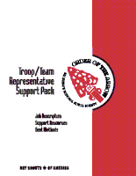
Resources
Official National Order of the Arrow Web Site
http://www.oa-bsa.org/programs/ttr/ttrintro.htm
OA Troop/Team Representative Support Pak 2001 printing
http://www.oa-bsa.org/programs/ttr/oatrpaktoc.htm

