Slide 1
eNewsletters
How-To

Slide 2
How Do We Connect Digitally?
Social media (Facebook, Twitter, Instagram, and Tumblr are used by the OA nationally)
Texting (Mass texting services like Remind101)
Website
Email Newsletters

Slide 3
Digital vs. Printed
Publications
Which style is best for your group?

Slide 4
Digital Publications
Pros
Inexpensive
Ease of access (might view on phone)
Easy to layout and format
Can integrate social media
Wide reach (can be sent to parents and Arrowmen)

Slide 5
Digital Publications
Cons
Can easily be ignored
Might not be delivered well (i.e. marked as spam)

Slide 6
Printed Publications
Pros
Prompts better recall
Does not rely on internet access

Slide 7
Printed Publications
Cons
Expensive
Environmentally unfriendly

Slide 8
Choosing Relevant Content
If the content is not relevant, you risk making the readers bored and disinterested

Slide 9
Choosing Relevant Content
Promotional – promote upcoming events
Updates – letters from officers/chairmen
Reports – summaries from past events
Historical – explain some historical aspect of OA

Slide 10
Choosing Relevant Content
Interview – asking a prominent person questions
Profile – gives the story of a prominent person
Best practices

Slide 11
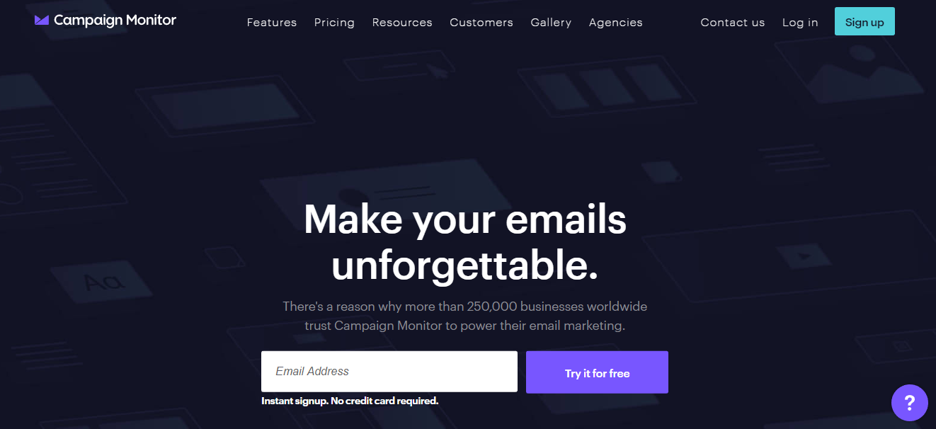
Designing Your Own eNewsletter

Slide 12
Thank you for joining us today!
Any questions?

