Slide 1
Creating the Cutting Edge Conclave
Planning and Developing Conclave

Slide 2
Learning Objectives
Explain the importance of, and how plan and develop a Conclave and all that it entails
Demonstrate how to plan specific areas of a Conclave program (i.e. activities, training, shows)
Guide brothers in the areas to focus on, the questions to ask, and where to go to get help
Enable Arrowmen to create a cutting edge Conclave that educates and inspires

Slide 3
What is the purpose of conclave?
This training session is titled,
“Planning and Developing Conclave”
Let’s begin with a simple question…
What do we have to consider when planning and developing a conclave?

Slide 4
Purpose
Provide a plethora of training opportunities to lodge leaders
Provide a forum for lodges to share ideas and best practices
Provide ideas and information on new programs developed by the Order
Provide lodge members to an opportunity to meet section, regional, and possibly national officers
Provide an opportunity for lodge officers and members to have fun and memorable weekend

Slide 5
Planning
Start with a back-dater
What are some important events or key planning dates that would be included on a back-dater?
Let's brainstorm the important milestones that need to be on our back-dater
Helpful hints:
Regular communication (Communication Plan)
Conclave promotion (Marketing and Promotional Toolkit)
Develop and foster a “Conclave Culture” within the Section
Define roles and expectations of Section Officers, Council of Chiefs, Conclave Vice Chiefs, and Service Lodge

Slide 6
Conclave Roadmap
Months 0-4 (Conclave Sunday Business Meeting and 1st COC)
Sunday Business Meeting
Elect new officers
Conclave presentation (by upcoming service lodge)
Basic promotions tool kit
1st COC
Review last year’s conclave report (successes and lessons learned)
Announce CVCs and Advisers
Approve conclave budget
Breakouts for CVCs (planning)
Camp visitation
Select conclave theme
Establish fee Structure and any other administrative Items
Get an estimate of attendance from each lodge regarding the upcoming conclave
Full promotional tool kit (in addition to what was previous distributed)
Newsletter articles, social media posts, etc.
Perhaps buttons or other wearable promotional items
Schedule lodge visitations by section offers to promote conclave at lodge events.
Establish incentives, competition, scholarships to lodges in order to foster early registration and increased attendance

Slide 7
Conclave Roadmap
Months 4-8 (2nd COC)
Confirmation from lodges regarding estimates on attendance (perhaps require this to be binding; you can always add up to a certain point, such as 2 weeks prior to the event)
Vote on conclave logo and other trading post items
Reports and breakouts by CVCs and the service lodge
Service lodge: Menu, amenities, special needs, and other relevant planning information
Training: identify core trainers and cells
Shows: outline of shows
Activities: outline of events
AIA: outline of AIA
Other CVCs/Committees: outlines
New promotional tool kit items (i.e., keeping it fresh)
Check-in with lodges regarding interest and promotions (identify weak points)

Slide 8
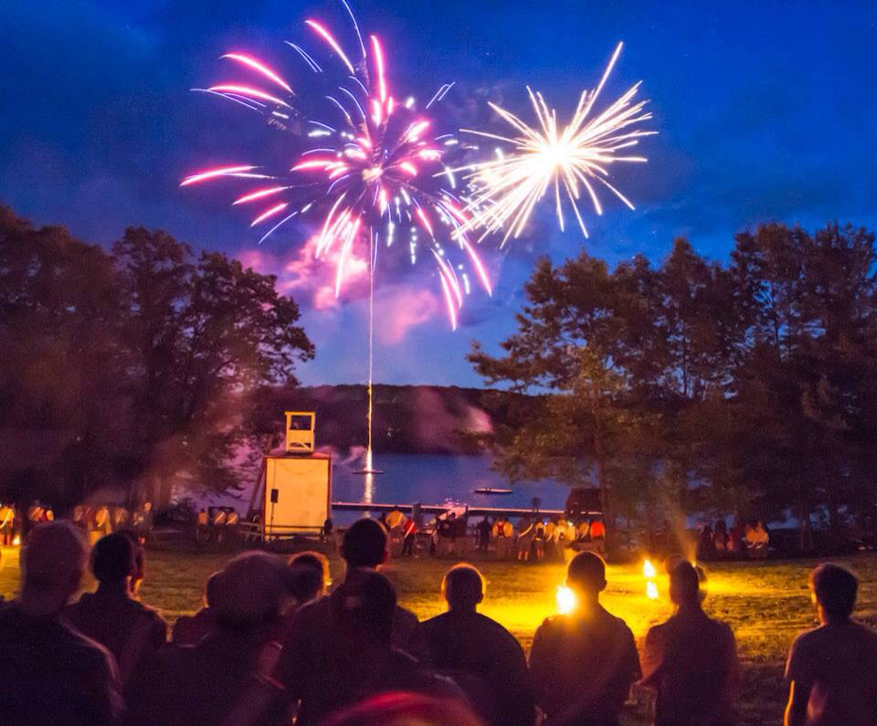
Conclave Roadmap
Months 8-12 (3rd COC – Count Down to Conclave)
Final reports from CVCs, service lodge, and COC. This intended to be a check-in with all of the heavy lifting occurring prior to this date
Identify final action items, travel plans, etc.

Slide 9
Scheduling
Conclave Schedule
Let's brainstorm important events that need to be on our schedule
While you may think your section’s schedule is set, it probably isn’t and changes can bring new life to a conclave
So what occurs Friday night? Saturday? Sunday?

Slide 10
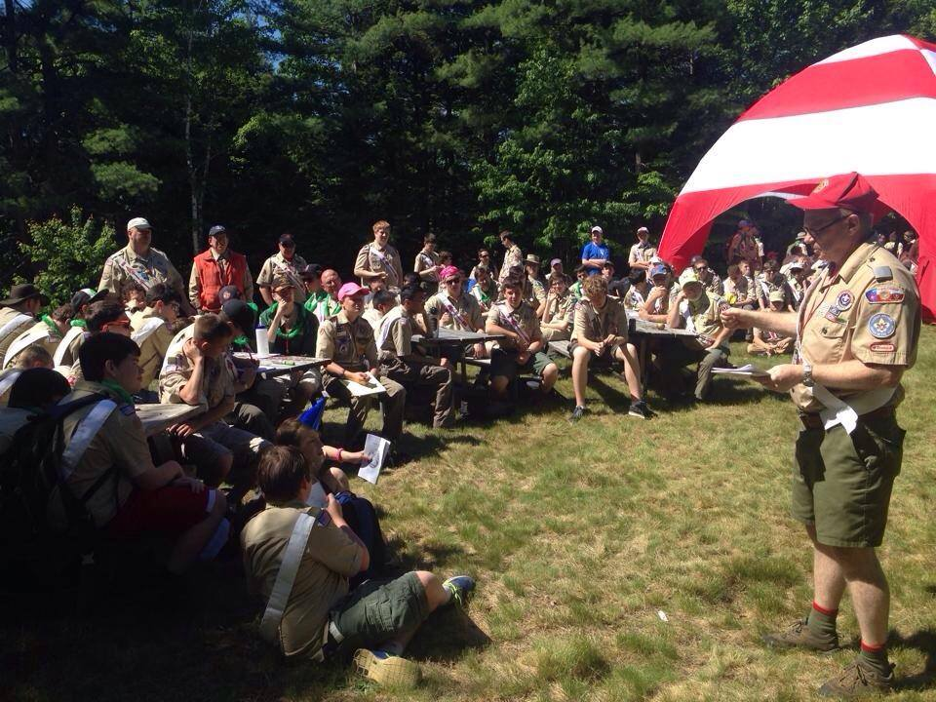
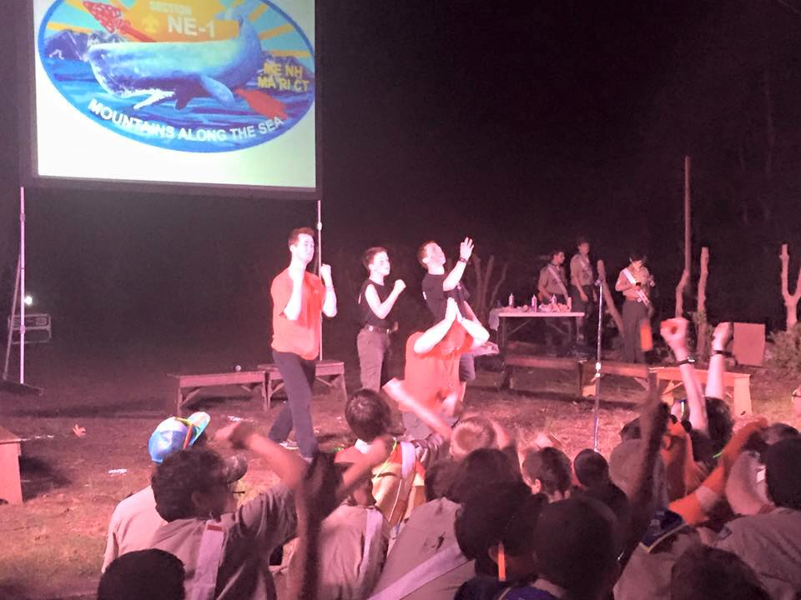
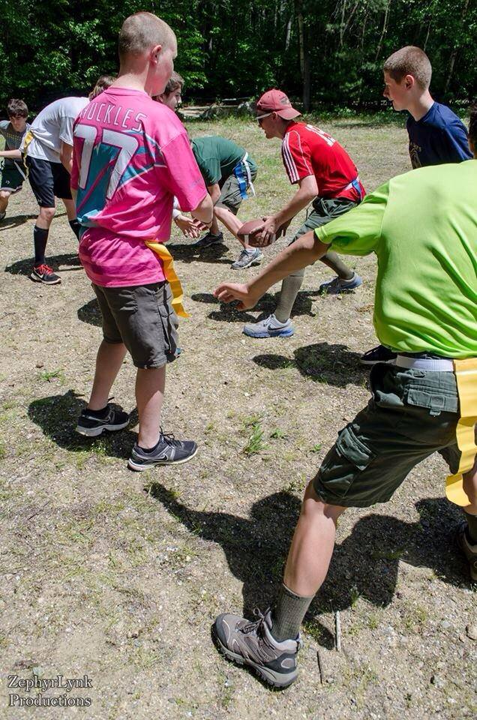
Program
The key sections of conclave program
Training
Activities
Shows
There must be something for everyone!
From the newest Arrowman to the oldest adviser…
Remember that program is the heart of the conclave

Slide 11
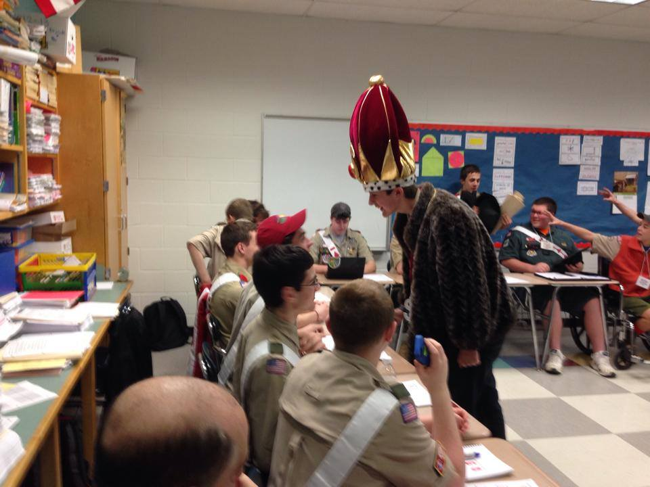
Training
Training isn’t always the thing participants leave a conclave remembering, but it is the one thing that can help strengthen our lodges and build better leaders
Make sure the training sessions cover a wide variety of topics and knowledge levels
Overview of training programs to consider
Open Sessions
“University Style” Sessions
We will do a deep dive into conclave training in a separate session

Slide 12
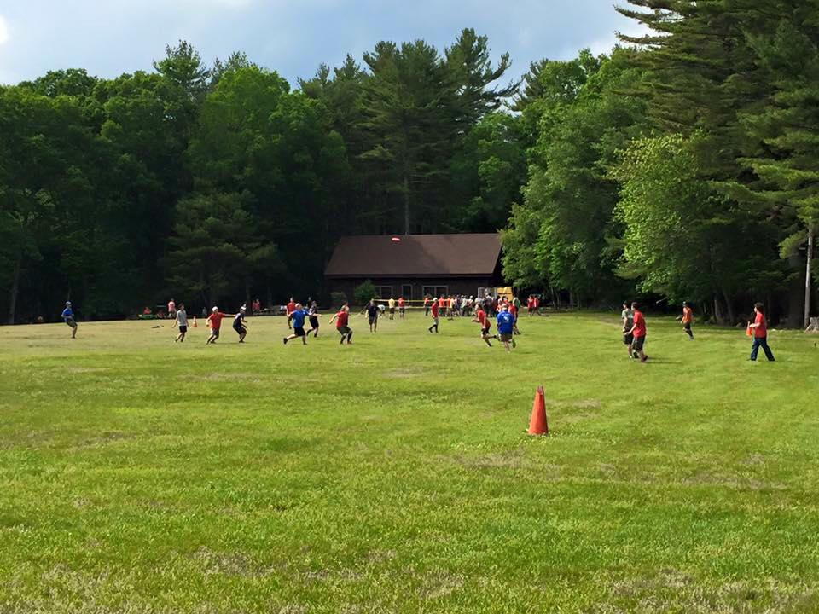
Activities
Some sections have a show on Friday night while some run activities then, and all sections have activities on Saturday afternoon
Sharing ideas and experiences
Group breakout topics:
American Indian
Camp-related (swimming, etc.)
Game shows
Food competitions
Sports, lodge competitions, etc.

Slide 13
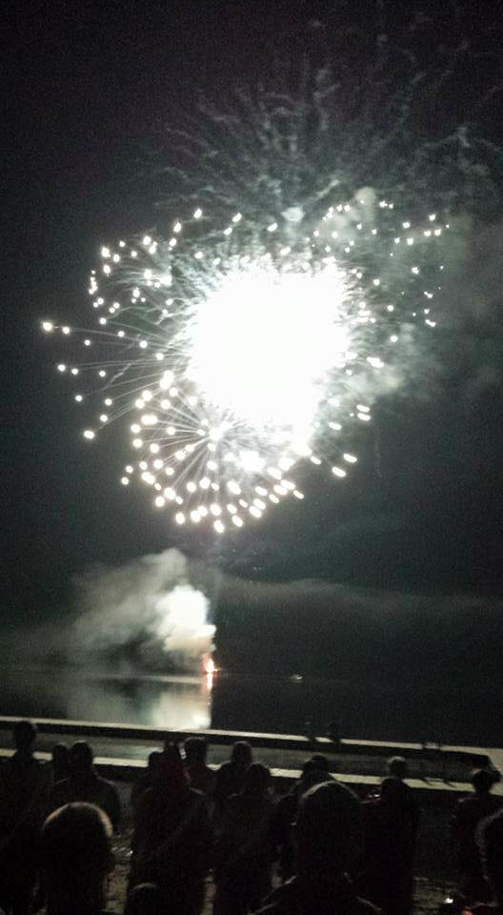
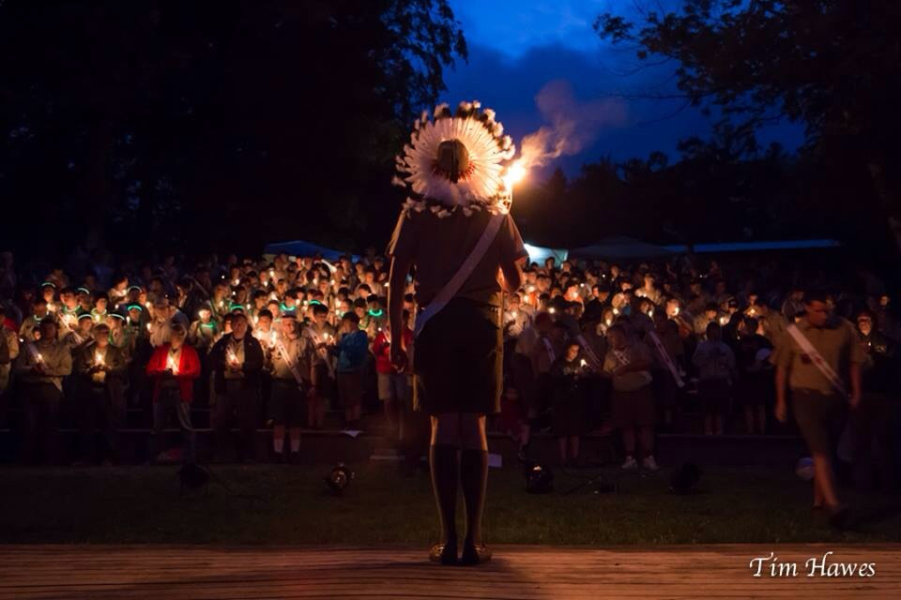
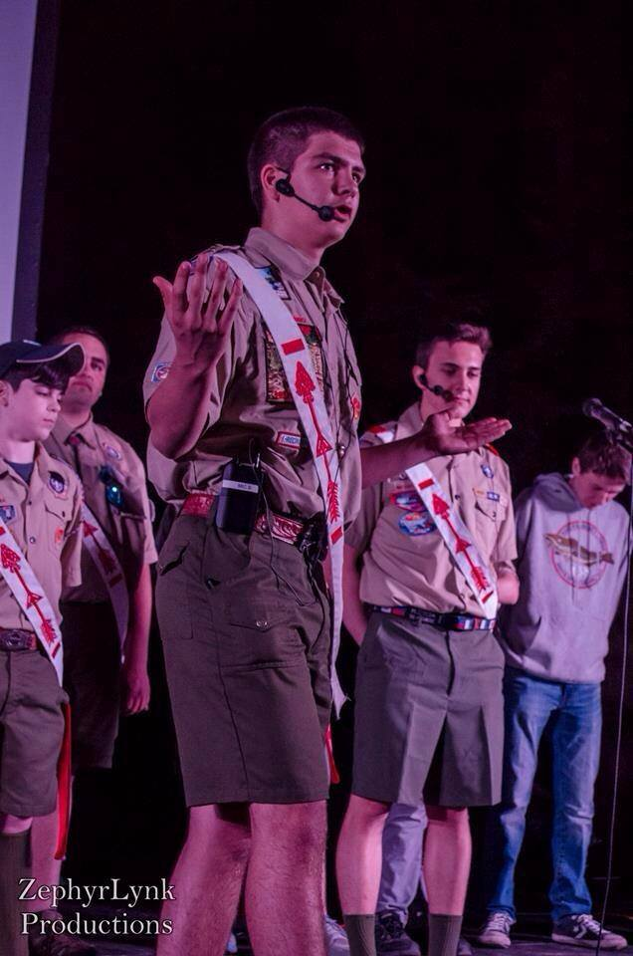
Shows
This can be the most memorable part of the conclave or it can be the biggest flop
It can be a very simple show like a camporee would have or it can be as elaborate as a NOAC stage show
Provide the right kind of show for your audience
Do something different each year
What types of shows have you seen?

Slide 14
W W W s of Logistics Planning
WATER
Make Sure Potable (Drinking) Water is Safe (Tested & Heath Certified)
Make Sure Drinking Water Is Available to Attendees During All Activities
WASTE
Plan for Solid Waste Management and Disposal
Sanitary Waste (Minimum of 3 Toilets Per 100 Attendees)
WELFARE (STAFF)
Safety (Site Safety Inspections & Check-in Safety Brief)
Telecommunications (Key Staff in “Real-time” by Radios/Smartphones)
Alerts (Fire, Bad Weather, etc. with Instructions & Assembly Points)
Food (Preparation/Serving, Food Kept Hot/Cold & Trained Preparers)
First Aid Station

Slide 15
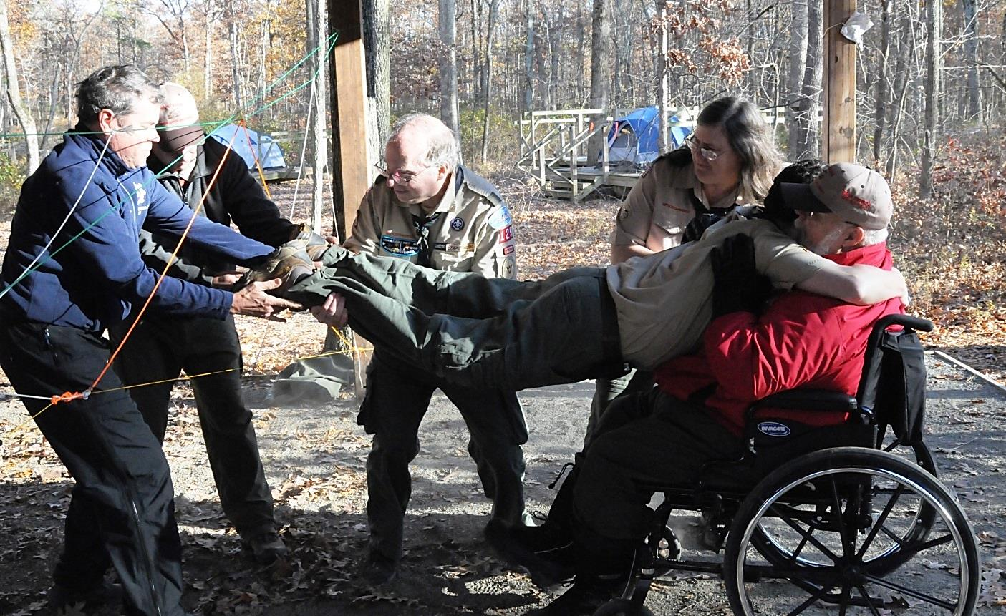
Physical Disabilities Accommodations
Be Prepared and Endeavor So Far As in Your Power Lies, to Be Unselfish in the Service and Devotion to the Welfare of Others
When Planning your Conclave, Remember to Plan How to Accommodate Persons With Physical Disabilities, such as:
Attendees in Wheelchairs
Attendees Who Are Deaf
Attendees Who Are Blind
Be Inclusive, NOT Exclusive
Some Activities Will Be Exclusive to Attendees With Disabilities
However, It Is NOT Difficult to Include Attendees with Disabilities at Conclaves if Accommodations Are Planned for in Advance

Slide 16
Duty to God
Lord Baden-Powell once said: "The Scout, in his promise, undertakes to do his duty to his king and country only in the second place; his first duty is to GOD. It is with this idea before us and recognizing that GOD is the one Father of us all, that we Scouts count ourselves a brotherhood despite the difference among us of country, creed, or class.”
Remember to Include:
An “Interfaith” Worship Service and Optional Faith-specific Worship Services Depending on Your Conclave’s Faith Demographics
“Interfaith” Invocations/Benedictions at Opening/Closing Ceremonies
“Interfaith” Prayers before Meals

Slide 17
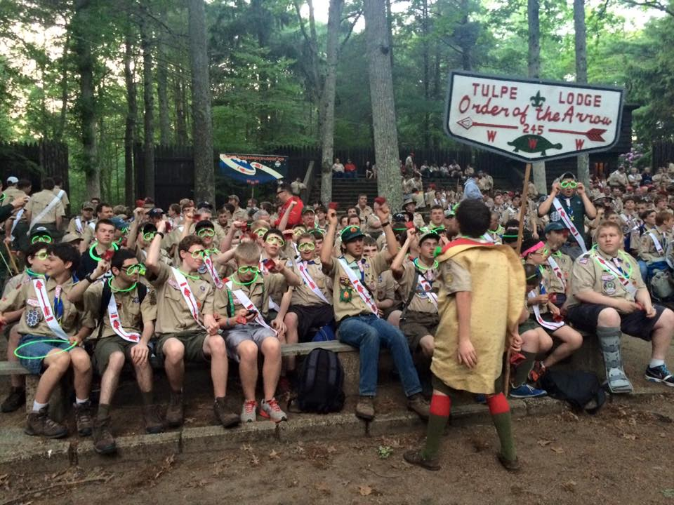
Summary
Conclave program areas: training, activities, and shows
New ideas to bring home to use at your upcoming conclave
Many different types of things you can do at a conclave
Provide a well-rounded program that is fun and engaging to everyone who is in attendance
If you do this, everyone will have a great time and it will be a conclave to remember

Slide 19
For Training Resources and More Information Visit:
http://training.oa-bsa.org/noac2015

