Slide 1
Dynamic Inspiration
Motivation

Slide 2
Introduction
Introduce the person to your right, strictly by guess work (please move if sitting by someone you know)
Introduce him/her with the name, age, year in school or occupation, and favorite hobby that you think belongs to them
Give reasons for your guesses

Slide 3
Olympic Athletes
Started in their sport at a young age
Stuck with it for a long time
Dedicated to multiple workouts a day
Dedicated to eating healthy
Persevered even when difficult
Often work in teams or with coaches

Slide 4
Inspire or Intimidate
Strong Relationships
Respect
Trust!

Slide 5
Profile review exercise
As a leader, your objective is to identify each individual’s strengths and learn how to motivate them using those strengths. Motivating everyone will help each other towards working together in order to develop a winning lodge (team) and deliver a successful program.

Slide 6
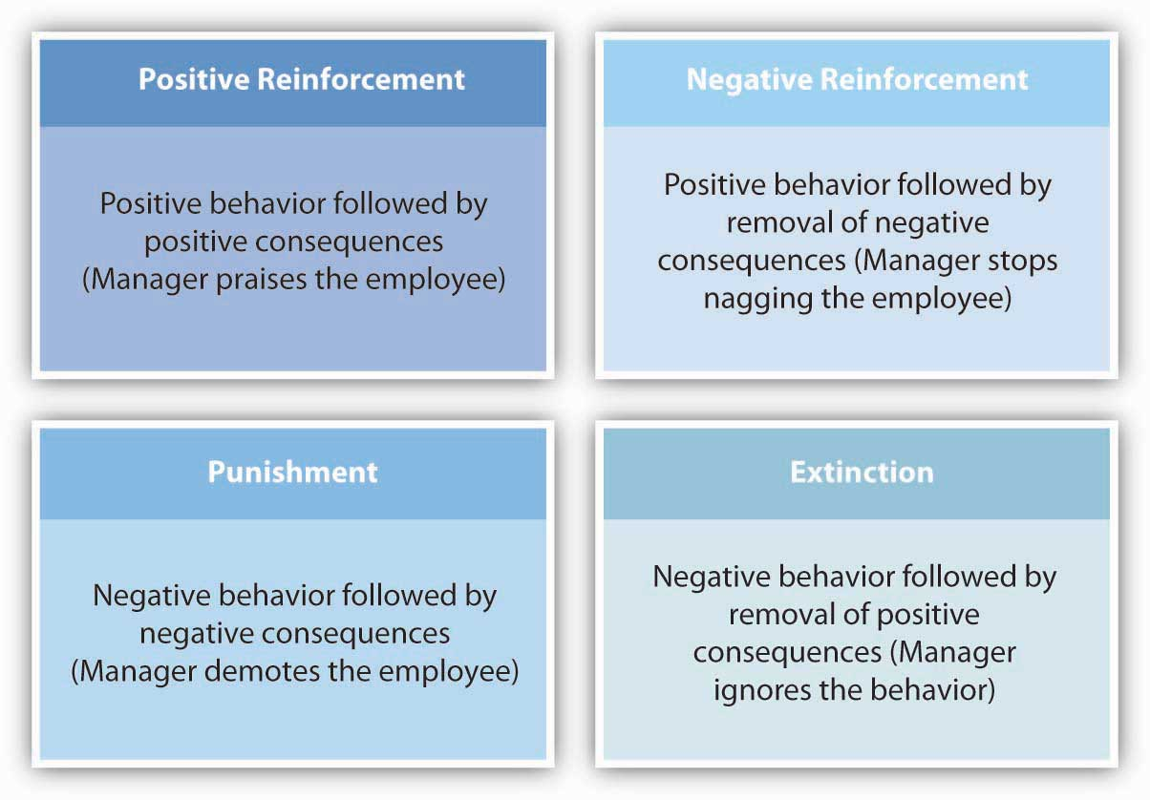
Evaluation

Slide 7
Nothing is successful without teamwork
Strong Relationships
Respect
Trust!

Slide 8
For Training Resources and More Information Visit:
http://training.oa-bsa.org/noac2015

