Slide 1
Goal Setting and Time Management
Lodge Leadership Development

Slide 2
Trainer Info
Add in your name, chapter/ lodge, and position in lodge/chapter if applicable.
Lodge Leadership Development

Slide 3
Icebreaker
This is where you will explain the icebreaker activity to the participants
Lodge Leadership Development

Slide 4
Where we are going
Help leaders prioritize goals and tasks effectively
Show Arrowmen the importance and significance of a to-do list and back dater
Identify areas of stress and effective ways to deal with these stressful environments
Recognize the importance of goal setting and how that can contribute to the success of a lodge
Lodge Leadership Development

Slide 5

Goal Setting
Lodge Leadership Development

Slide 6
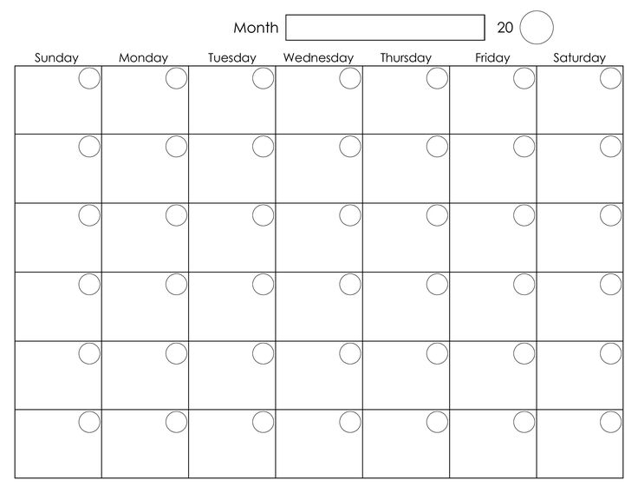
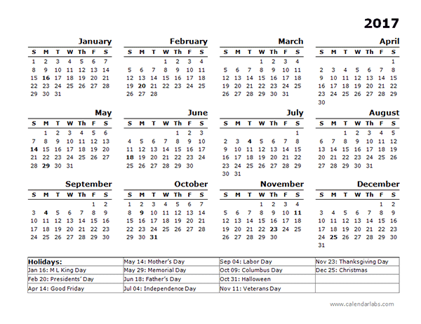
Types of goals
Short-Term
Long-Term
Lodge Leadership Development

Slide 7

Short-Term
Take a few days, weeks, or months, but no more than 6 months
Could support a Long-Term goal
Ex. Getting all A’s on your report card
Lodge Leadership Development

Slide 8

Long-Term Goal
Generally take more than 6 months to complete
They are more complicated and require more work in comparison to Short-Term goals
Ex. Getting into your dream college
Lodge Leadership Development

Slide 9

S.M.A.R.T Goals
S
  Specific
  Making sure everything is laid out logically and clearly so there is no room for confusion or misinterpretation
Lodge Leadership Development

Slide 10

S.M.A.R.T Goals
M
  Measurable
  It is clear when the goal is obtained
Lodge Leadership Development

Slide 11

S.M.A.R.T Goals
A
  Attainable
  The goal can actually be completed and accomplished
Lodge Leadership Development

Slide 12

S.M.A.R.T Goals
R
  Relevant
  You want the goals to somehow be relevant to your life, and what you want to accomplish
Lodge Leadership Development

Slide 13

S.M.A.R.T Goals
T
  Timely
  You have to have a time frame of the completion of the goal to help keep you motivated
Lodge Leadership Development

Slide 14
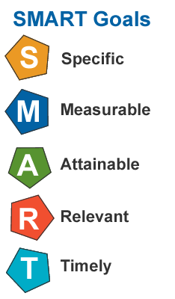
Practice
Write down two Short-Term goals and two Long-Term goals
Make sure the goals are S.M.A.R.T Goals
Lodge Leadership Development

Slide 15
Carrying Out Your Goals
Lodge Leadership Development

Slide 16
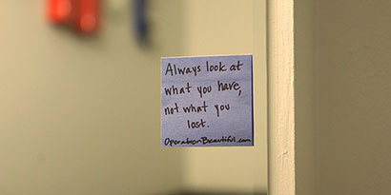
Working towards your goal
The best way to keep on track?
  Write the goal down and keep it where you will see it constantly
Lodge Leadership Development

Slide 17
Effective Time Management
Lodge Leadership Development

Slide 18
Prioritizing Tasks
Make sure you do things in the order that they’re due
It’s important to do the most important and things that are due first, rather than those that are due later
Lodge Leadership Development

Slide 19
Dealing with Stress
Good Stress
Bad Stress
Lodge Leadership Development

Slide 20

Good Stress
Keeps you focused and making your tasks are getting done and getting done on time
Ex. Stressing about if you studied enough for your upcoming math test
Lodge Leadership Development

Slide 21

Bad Stress
Very unhealthy and should be avoided
Stressing many things all at once and for an extended period of time
Can actually keep you off track and prevent you from getting work done
Lodge Leadership Development

