Slide 1
Recognizing Tomorrow’s Leaders
Session 5

Slide 2
Learning Outcomes
Explain the basics of an Order of the Arrow unit visitation
Develop an effective structure to oversee the unit visitation process
Create a plan to innovate and improve lodge unit election rates.

Slide 3
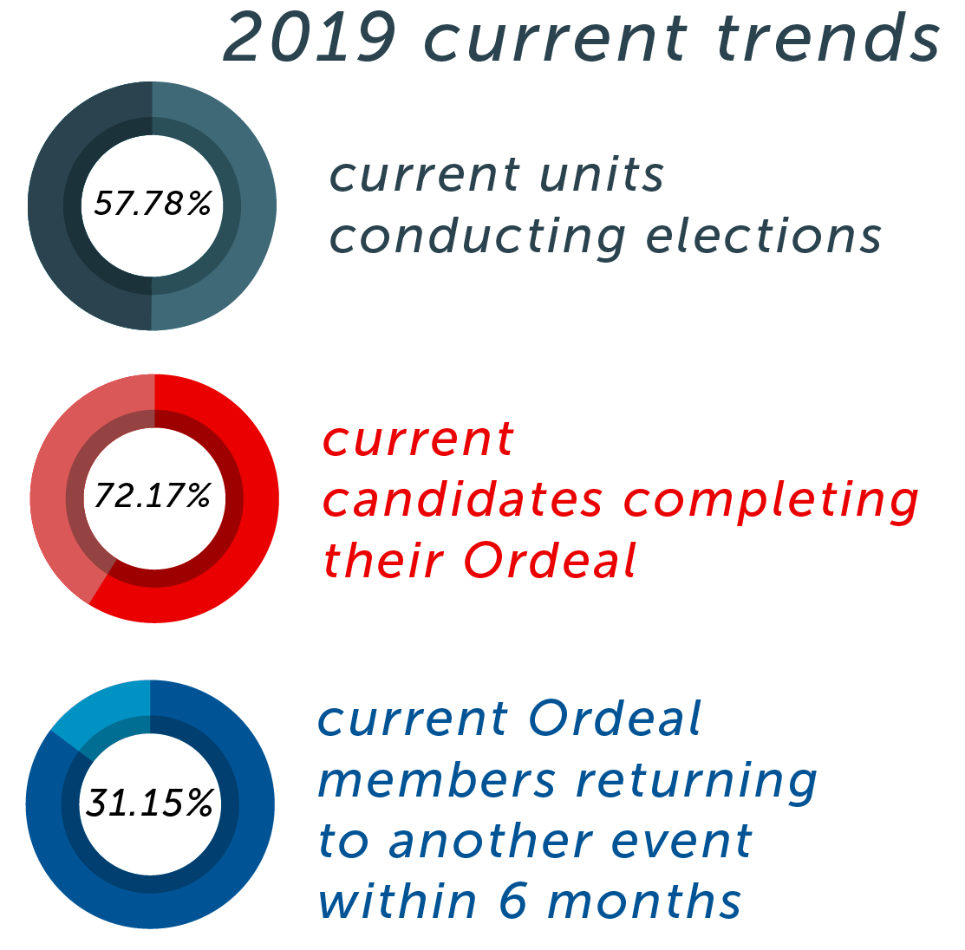

Slide 4
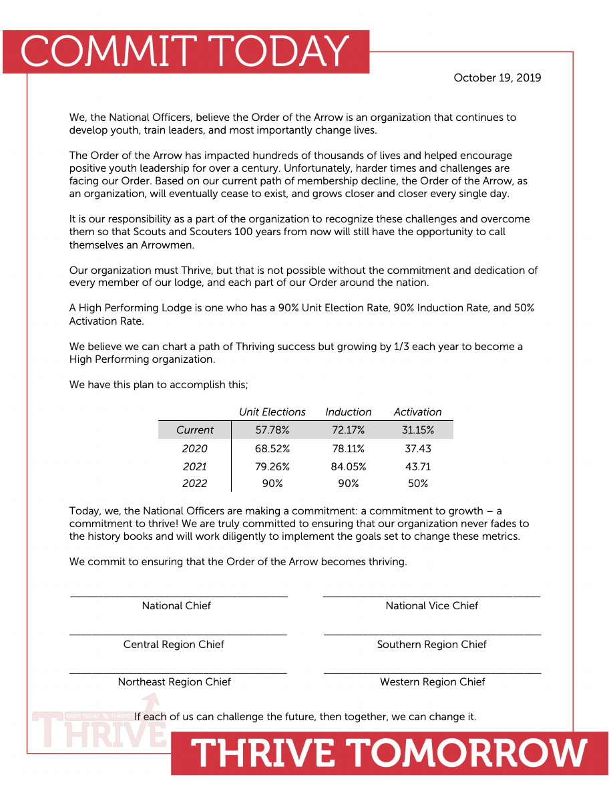
Declaration To Thrive

Slide 5
Why Should We Care?
How do Unit Visitations help us grow our membership?
How can we make Unit Visits impactful?
What are the biggest obstacles we face to achieving a 90% unit election rate?

Slide 6
The Breakdown: How to Conduct a Unit Visitation

Slide 7
Unit Visitation Challenges Experience

Slide 8
ACTion Ideas
How can your lodge hit the next benchmark to achieving a High Performing unit election rate?

