Slide 1
The Next Generation
Session 6

Slide 2
Learning Outcomes
Explain the basics of the induction process.
Explain the significance and importance of communicating with and making an impact on newly elected candidates.
Create a plan to innovate and improve lodge induction rates.

Slide 3
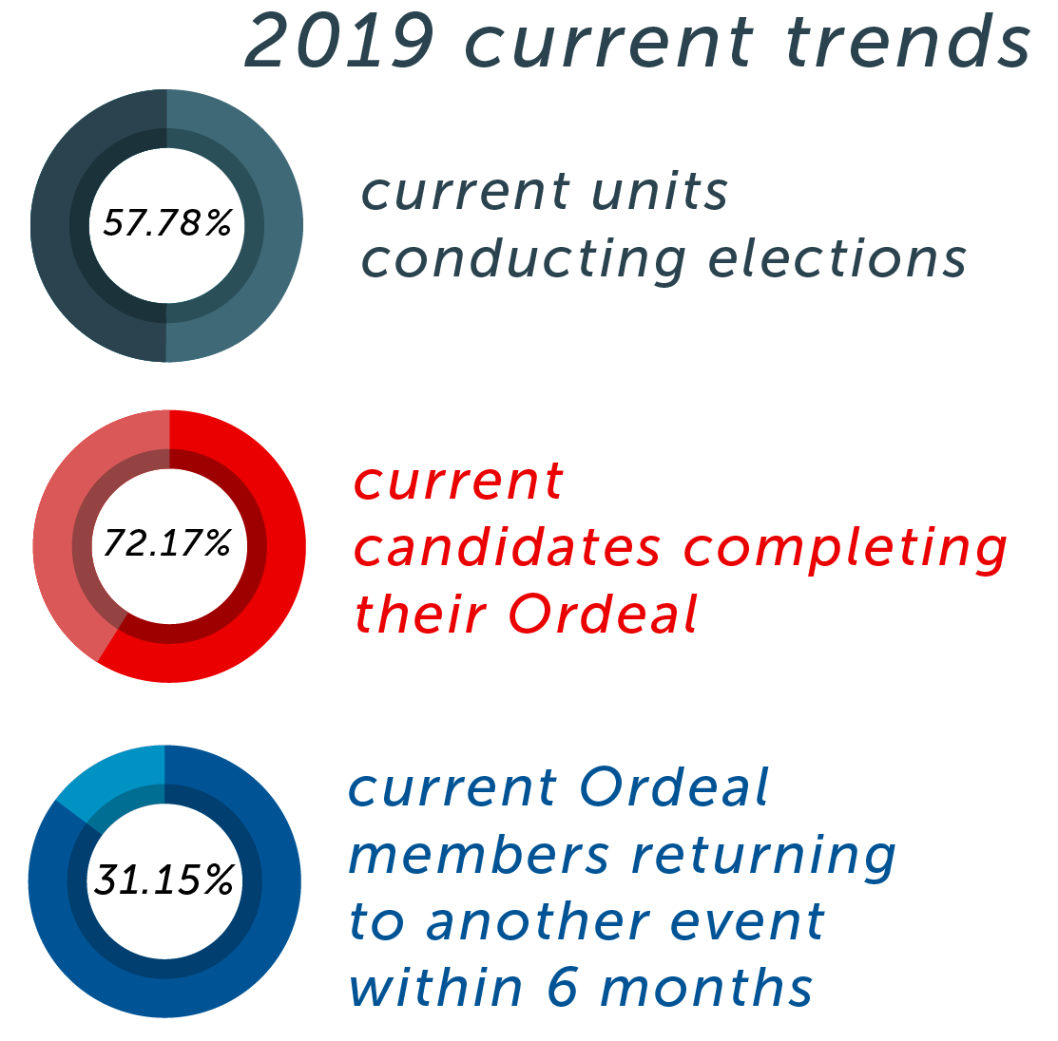

Slide 4
Induction Barriers Experience

Slide 5
Induction Barriers
The candidate does not have a ride to the Ordeal
The candidate does not know anyone in the OA or any other candidates planning to attend
The candidate’s parents are not comfortable with sending them to the Ordeal
Money is an issue in registering for the Ordeal
The candidate wants to attend sports or other activities

Slide 6
Induction Rate Resources
OA Welcome Session
Provides information to Parents and Candidates after being called out but before the Induction
Email, Phone, Video, and Letter templates
Helping to communicate with Candidates between the Election and Induction
All resources can be found at oa-bsa.org/thrive.

Slide 7
Recruiting and Utilizing Elangomats

Slide 8
ACT Timer (2 mins.)

Slide 9
ACTion Plan
How can your lodge hit the next benchmark to becoming a High Performing Lodge in the category of Induction Rate?

