Slide 1
Role of The Key 3
Presented by Chris Gilbert

Slide 2
Introductions
What is your name?
Where are you from?
What are your current roles in Scouting?
Why did you decide to take this cell?

Slide 3
Role of The Key 3
Are these folks Avengers? Special Forces? EMS?
Team
Purpose of Excellence (before the journey can begin)

Slide 4
Description of the Session
Explore the roles of each member of The Key 3 so we can better understand how they relate and help each other.
Who are The Key 3 really?

Slide 5
Learning Objectives
What are the goals of The Key 3?
What key skills do they need to be effective?
How can they best serve your lodge, chapter, unit, council?

Slide 6
The Key 3
The Lodge Chief
The Lodge Advisor
The Staff Professional Advisor

Slide 7
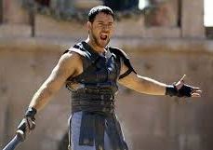
The Key 3
The Lodge Chief

Slide 8
The Key 3
The Lodge Chief
Fly in responsibilities

Slide 9
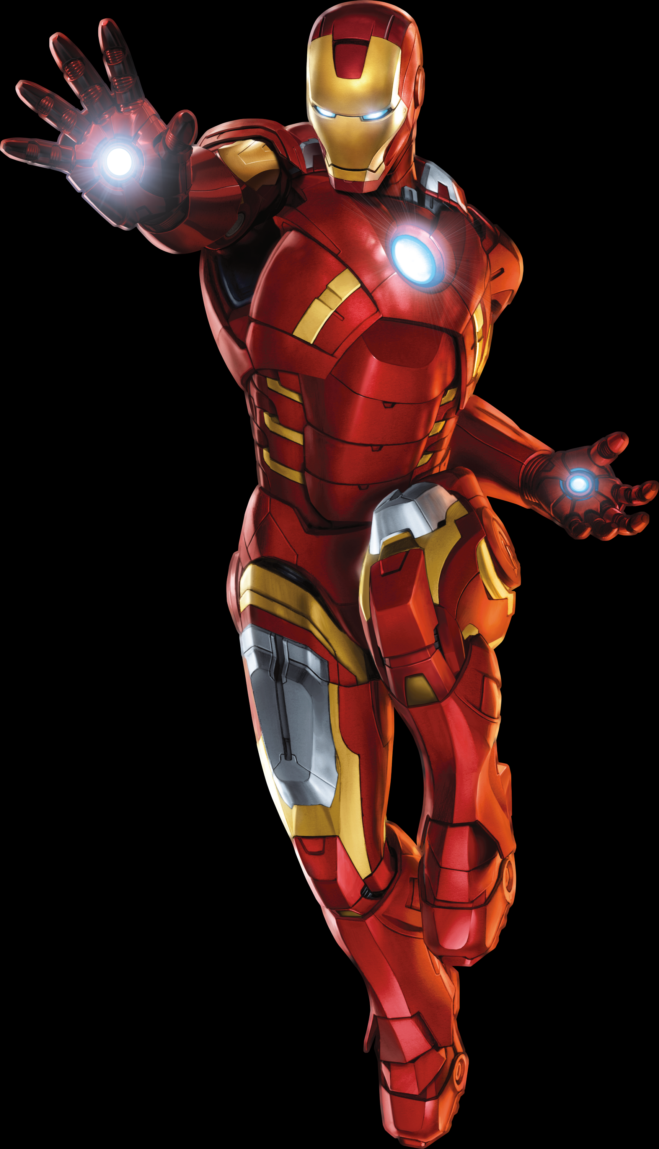
The Key 3
The Lodge Advisor

Slide 10
The Key 3
The Lodge Advisor
Fly in responsibilities

Slide 11
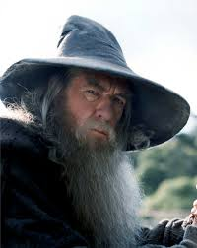
The Key 3
The Staff Professional Advisor

Slide 12
The Key 3
The Staff Professional Advisor
Fly in responsibilities

Slide 13
The Key 3
With The Key 3 responsibilities also on flip-chart work with attendees to draw parallels between each role
Develop the parallels through class participation
Brew the mixture down to effective communication being the most important skill

Slide 14
Training Materials
Three 3M flip charts with self-adhesive, graph paper pages that can be posted on the walls
Flip chart pens, multiple colors
Three floor-type easels that are sturdy
2-sided adhesive tape, quick release type
Projector for power point, I will bring my laptop [VGA and/or HDMI will work]

Slide 15
Ancillary Materials
Representations of visual aids
PowerPoint slides
Set displays (working on this)
Video or audio files (thumb-drive or cloud) I would like to use a few brief video files to demonstrate effective conflict resolution through effective communication…i.e. Remember the Titans, Avengers (first movie)

Slide 16
Questions & Comments
Instructor, Christopher Gilbert Scoutmaster158@gmail.com
Skills for Advisors, Cell Lead, Carlos Lopez antelope0509@yahoo.com

Slide 17
For Training Resources and More Information Visit:
http://training.oa-bsa.org/noac2015

