Slide 1
The Youth to Adult Transition:
Redefining the Youth/Adult Role

Slide 2
Trainer Introduction
3rd NOAC (2nd on Training Staff)
Former Lodge Chief & Section Vice Chief
Eagle Scout 2009
Recent experience w/ Youth to Adult transition in the OA

Slide 3
Session Questions
Are the roles and goals in the OA the same for Youth and Adults?
What is the role of the Youth in the OA?
What is the role of the Adults in the OA?
How do the roles of the Youth/Adults interact?
How do we build synergetic relationships?

Slide 4
E.xplain D. G. E.
The OA is a youth-lead organization but not a youth-only organization
Both youth and adults seek to achieve the Mission and Purpose of the OA (revised 2009)

Slide 5
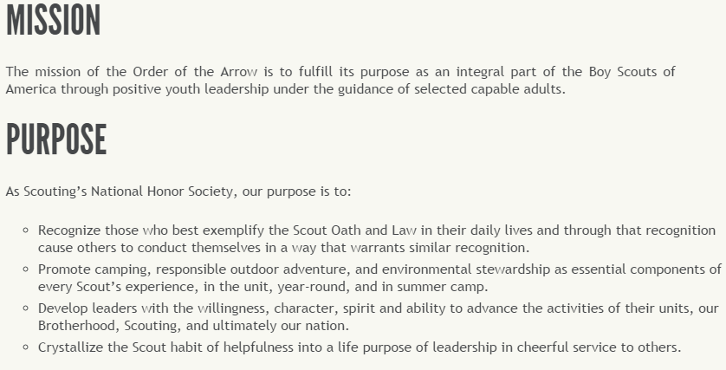
E.xplain D. G. E.

Slide 6
E.xplain D. G. E.
The underlying reason adults are involved in the Order is to provide young men with the opportunity to develop into leaders of character

Slide 7
E. D.emonstrate G. E.
Situation 1: Participation at the last Lodge Service Project was disappointing and the Lodge has an important and very public Community Service Project in 2 months

Slide 8
E. D.emonstrate G. E.
Situation 2: Lodge Membership over the last 3 years has been stagnant

Slide 9
E. D.emonstrate G. E.
Situation 3: The Unit Elections Team has completed unit elections in only 25% of the council troops due primarily due to reluctant Scoutmasters and the limited time of the current Unit Election Team members

Slide 10
E. D. G.uide E.
Actors Desired
Denis (Youth)
John (Advisor)
Sam (Youth)
Bob (Advisor)
Andy (Advisor)
Patrick (Youth)

Slide 11
E. D. G.uide E.
Scenario 1: The Show Must Go On
Scenario 2: Help Without Helping
Scenario 3: Lodge Success?

Slide 12
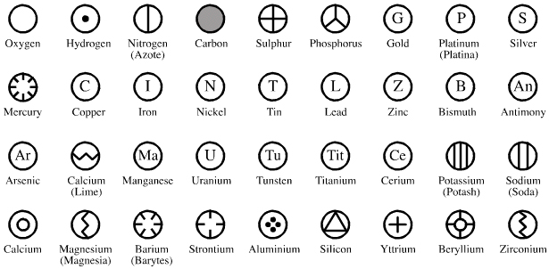
E. D. G. E.nable
What elements are required for good working Adults/Youth relationships?

Slide 13
E. D. G. E.nable
What traits should the Youth bring to the table to help achieve the Lodge’s goals?

Slide 14
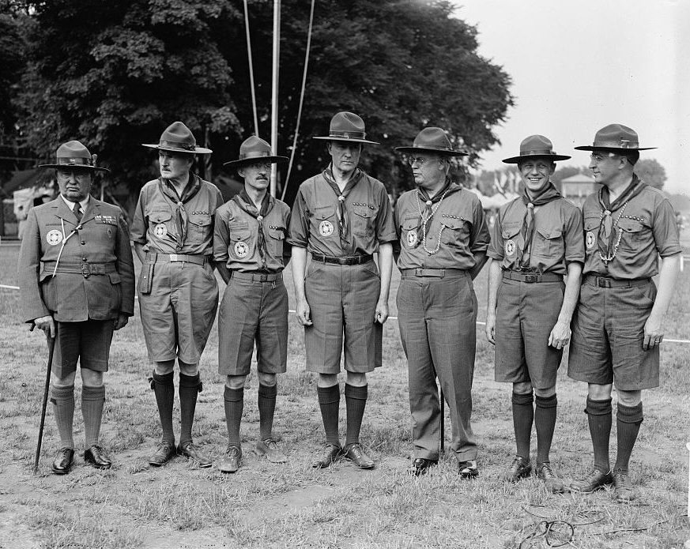
E. D. G. E.nable
What traits should the Adults bring to the table to help achieve the Lodge’s goals?

Slide 15
Session In Review
Synergy – the interaction or cooperation of two or more organizations, substances, or other agents to produce a combined effect greater than the sum of their separate effects

Slide 16
Session Questions (In Review)
Are the roles and goals in the OA the same for Youth and Adults?
What is the role of the Youth in the OA?
What is the role of the Adults in the OA?
How do the roles of the Youth/Adults interact?
How do we build synergetic relationships?

