Slide 1
Internet and Social Media
eScouting

Slide 2
Agenda
What can social media do for my lodge?
Lodge Websites
Facebook
Instagram
Snapchat
Pinterest
Twitter
TEXTing
What gives the best results?
A Social Media survey, and the results
How do we use Social Media Safely
What should your lodge do to be effective?
Conclusions
Questions?
What should your lodge do to be effective?

Slide 3
What can Social Media do for my lodge?
Communication and engagement with members is one of the hardest things for any lodge to do effectively. As an additional resource to the lodge website, social media can play an important part of any lodges’ communication and promotion plan.
How many of you are part of a lodge that uses a lodge website to communicate with their members?
How many of you are part of a lodge that uses social media to communicate with their members?
How many of you feel that the use of social media is effective in communicating with the lodge members?
I hope your lodge is being efficient in it’s use of social media, but it may not be.
I plan to give you information that will allow your lodge to tune it’s social media program and be more effective for less work!

Slide 4
What can Social Media do for my lodge?
Show of hands from the audience….
How many of you use Facebook? How often do you look at it or make posts?
How many of you use Instagram? How often do you share pictures or video on Instagram?
How many of you use Snapchat? How often send a picture or video to someone?
How many of you use Pinterest? How often do you post a picture or video (a “Pin”) to Pinterest?
How many of you use Twitter? How often do you Tweet? (140 character limit…)
How many of you send and received TEXTs? How often?

Slide 5
What can these site do for your lodge?
Can any of these sites really make a difference for your lodge?
What are the specific aspects of these sites that make them useful for your lodge to communicate and engage your members?
What are the risks of using these sites?
How can you protect your lodge members from abuse associated with social media sites?

Slide 6
A Lodge Website
A lodge website can be a great portal for information for your lodge!
The key is making it useful so the members go back to it for information regularly.
A good website provides information on upcoming events, details on past events, pictures, the lodge calendar, resources for members, the ability to register for events, etc.
http://oa466.org/
http://www.lodge104.net/
http://www.tecumseh65.org/
One of the key aspects of a lodge website it to keep it up to date. Nothing will kill visits like out of date information.

Slide 7
Facebook is an online social networking service.
After registering to use the site, users can create a user profile, add other users as "friends", exchange messages, post status updates and photos, share videos and receive notifications when others update their profiles.
Users may join common-interest user groups, organized by workplace, school or college, or other characteristics, and categorize their friends into lists such as ”Hungteetsepoppi Lodge" or "Western Region, Order of the Arrow".
Facebook is a great way to post lodge events (upcoming and past), display pictures and videos, and engage members with a pretty sophisticated user interface.
Facebook had over 1.44 billion monthly active as of March 2015.
Data and statistics from Wikipedia

Slide 8
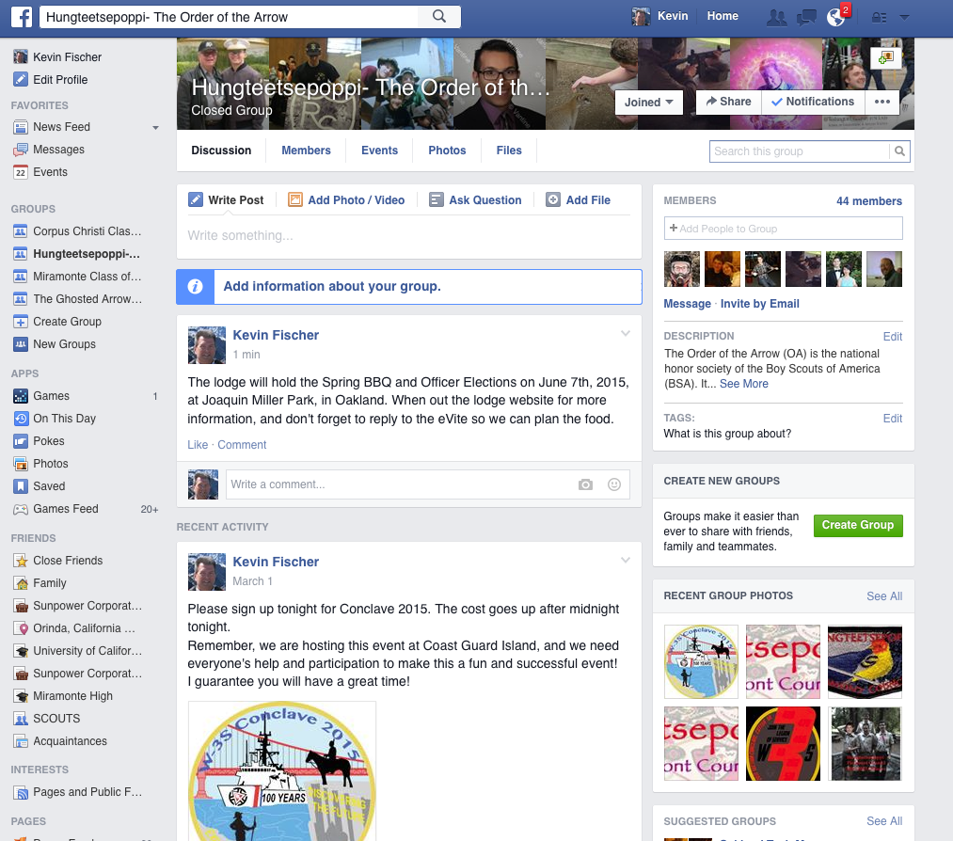

Slide 9
Instagram was created and launched in October 2010.
Instagram is an online mobile photo, video sharing and social networking service that enables its users to take pictures and videos, and share them on a variety of social networking platforms, such as Facebook and Twitter.
A distinctive feature is that it confines photos to a square shape, similar to Kodak Instamatic and Polaroid images, in contrast to the 4:3 aspect ratio typically used by mobile device cameras.
The service was acquired by Facebook in April 2012.
Instagram is a mobile App distributed through the Apple App Store, Google Play, and Windows Phone Store.
Post pictures and videos from your lodge’s latest events, and have them shared onto your Facebook page, Twitter, etc.
Data and statistics from Wikipedia

Slide 10
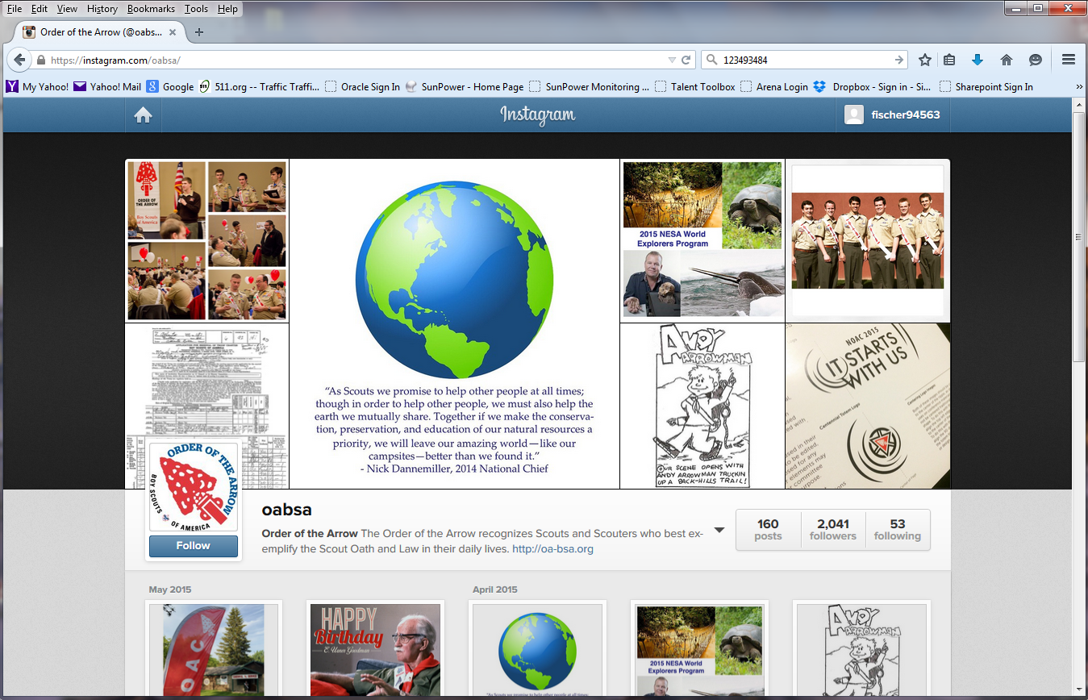
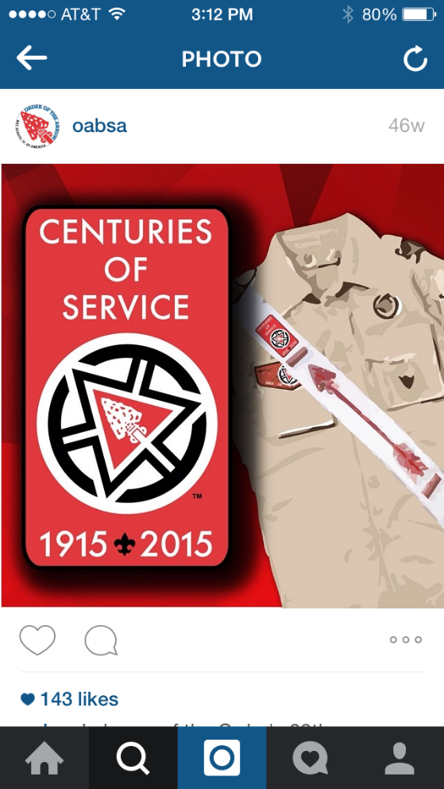

Slide 11
Snapchat is a video messaging application.
Users can take photos, record videos, add text and drawings, and send them to a controlled list of recipients. These sent photographs and videos are known as "Snaps".
Users set a time limit for how long recipients can view their Snaps (as of March 2015, the range is from 1 to 10 seconds), after which they will be hidden from the recipient's device and deleted from Snapchat's servers.
The application's main demographic consists of users between 13 and 23 years of age.
Can this be used to promote the OA successfully, or is this app targeted to a different purpose?
Envision what a teenager would use this for, where the evidence is erased in 1-10 seconds….
Data and statistics from Wikipedia

Slide 12
Pinterest is a web and mobile application company, which operates a photo sharing website. Registration is required for use.
Users can upload, save, sort, and manage images—known as pins—and other media content (e.g., videos and images) through collections known as pinboards.
Pinterest acts as a personalized media platform. Users can browse the content of others on the main page. Users can then save individual pins to one of their own boards using the "Pin It" button, with Pinboards typically organized by a central topic or theme.
Users should keep in mind that Pinterest stores actual copies (not just thumbnails and links) of the images being pinned.
Data is not private.
Data and statistics from Wikipedia

Slide 13
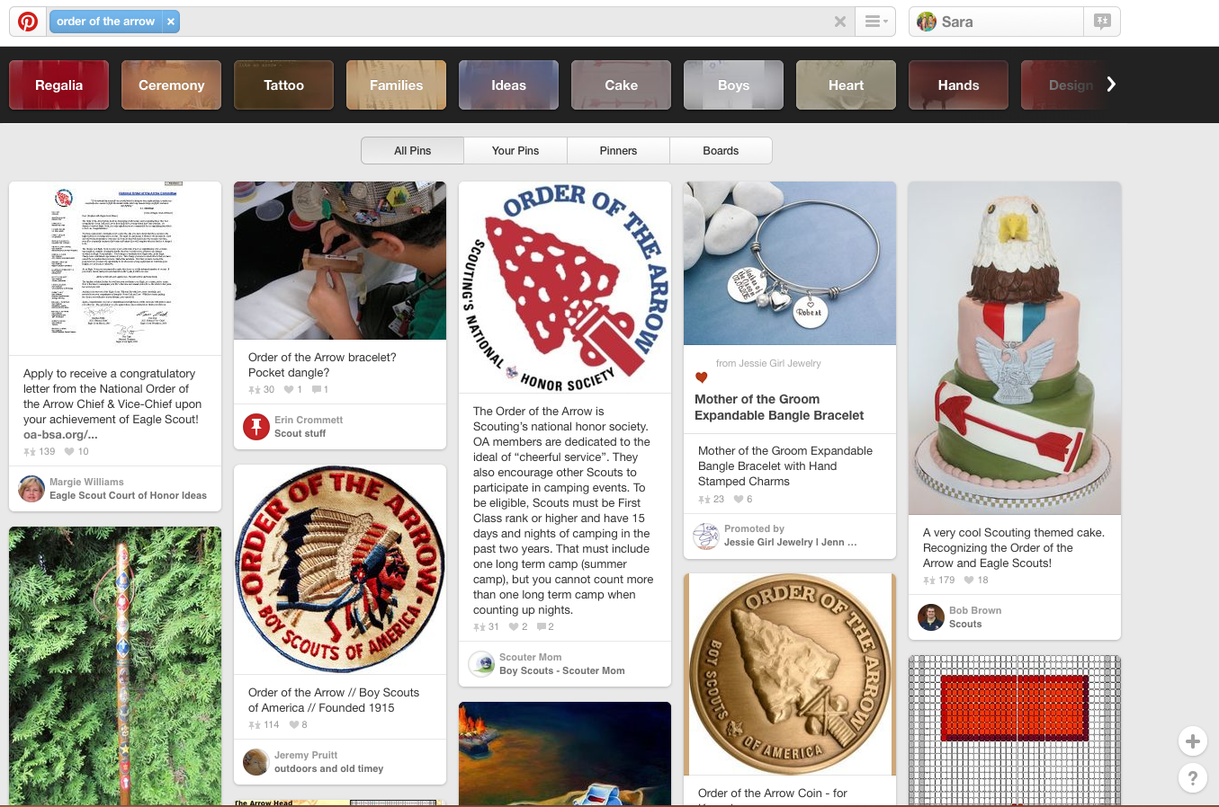

Slide 14
Twitter is an online social networking service that enables users to send and read short 140-character messages called "tweets".
Registered users can read and post tweets, but unregistered users can only read them. Users access Twitter through the website interface, SMS, or mobile device app.
As of May 2015, Twitter has more than 500 million users, out of which more than 302 million are active users.
Tweets are publicly visible by default, but senders can restrict message delivery to just their followers. Users can tweet via the Twitter website, Smartphones, or SMS.
Retweeting is when a tweet is forwarded via Twitter by users. Both tweets and retweets can be tracked to see which ones are most popular.
According to research published in April 2014, around 44 percent of user accounts have never tweeted.
Data and statistics from Wikipedia

Slide 15
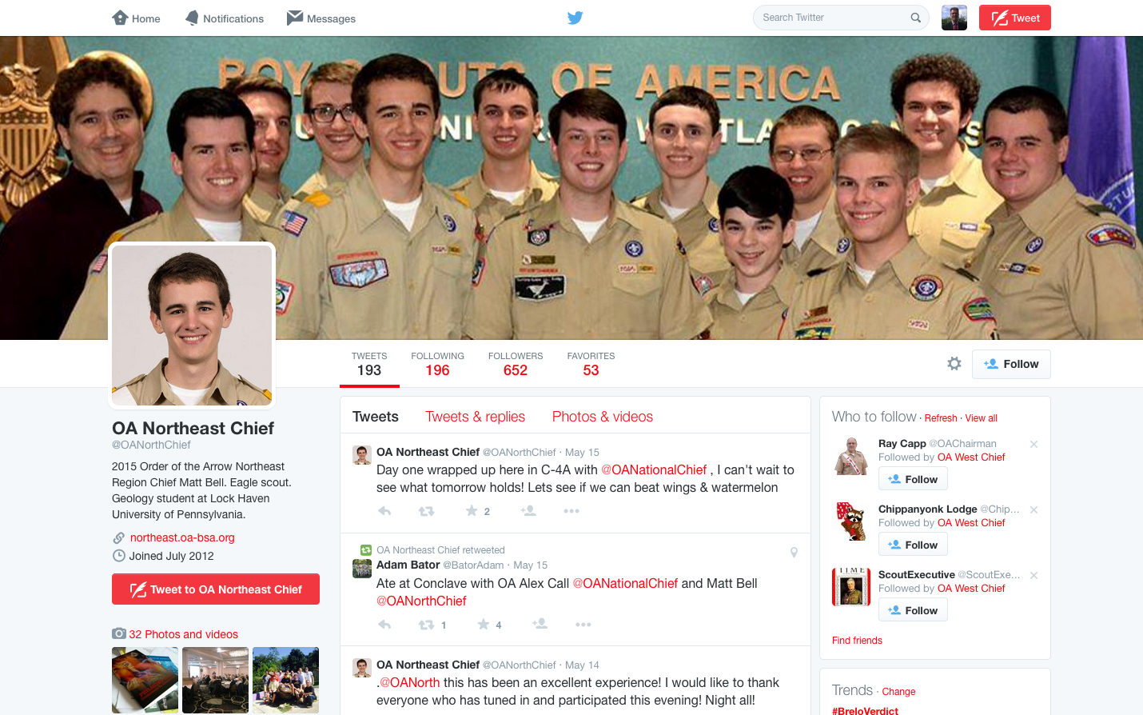

Slide 16
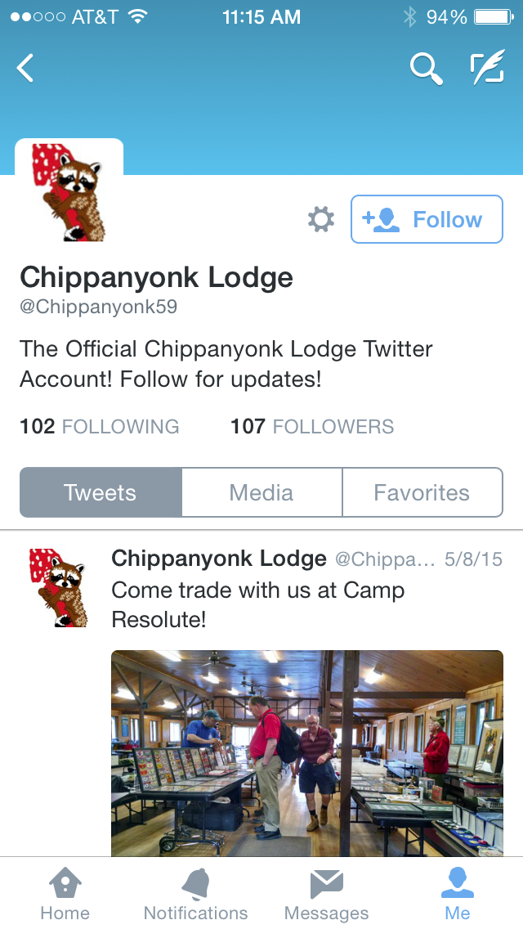
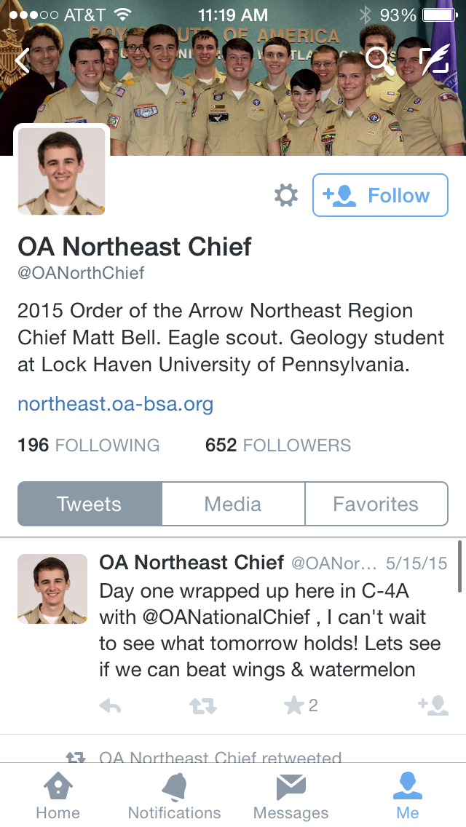
Data and statistics from Wikipedia

Slide 17
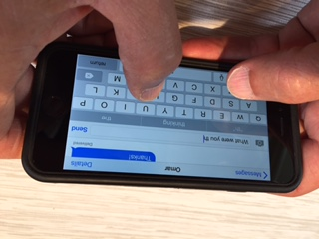
Text Messaging for OA communications
Text messaging, or texting, is the act of composing and sending brief, electronic messages between two or more mobile phones, or fixed or portable devices over a phone network.
The term originally referred to messages sent using the Short Message Service (SMS). It has grown to include messages containing image, video, and sound content (known as MMS messages).
The sender of a text message is known as a texter, while the service itself has different colloquialisms depending on the region.
In a straight and concise definition for the purposes of this English language article, text messaging by phones or mobile phones should include all 26 letters of the alphabet and 10 numerals, i.e., alpha-numeric messages, or text, to be sent by texter or received by the textee.
Data and statistics from Wikipedia, Pew Research Center, and Forbes

Slide 18
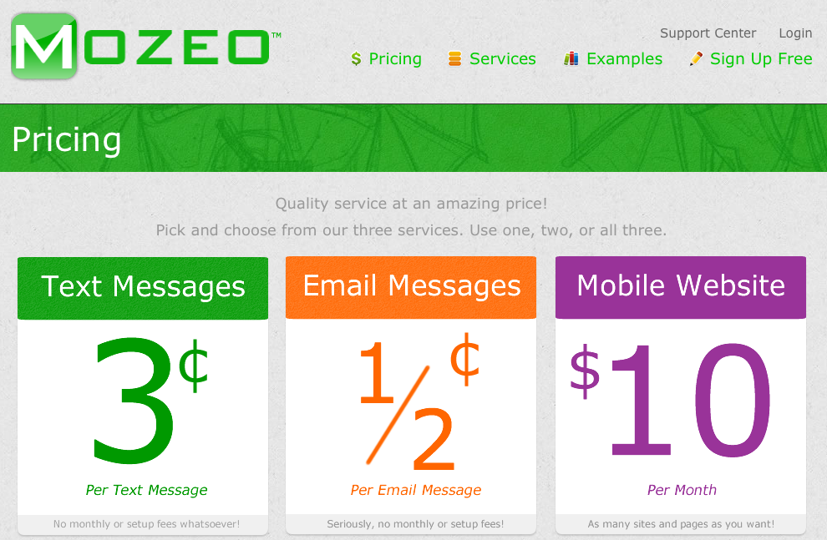
Text Messaging for OA communications
Text Messages have a 98 percent read rate
Text Messages have a nearly 100 percent open rate
Texts are typically read within 15 minutes of being received
Smart Mobile phones have reached nearly 64 percent penetration in the United States as of Jan 2014 (so higher now)
Sites exist that can help you with your lodge communications, if you are willing to pay….
Data and statistics from the Pew Research Center for Internet, science and Technology, Forbes.com, Fifty Essential Mobile Marketing Facts

Slide 19
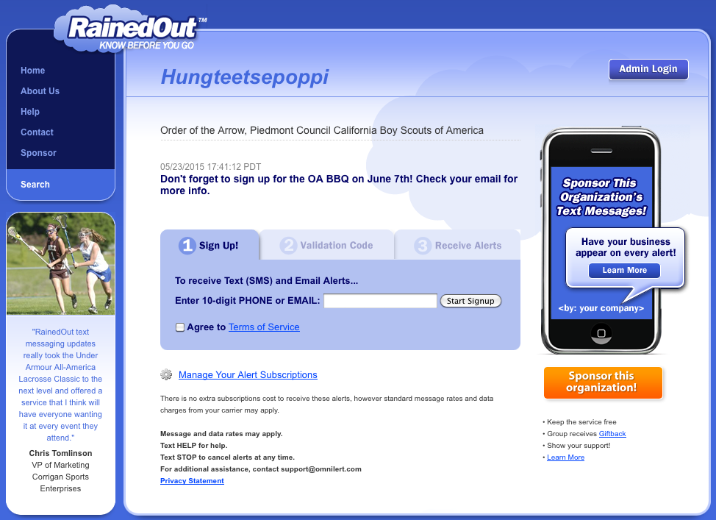
There are free options for messaging your members…

Slide 20
So which social media “methods” will give me the best results in my lodge?
There is no one “silver bullet” that will solve all your communications and engagement issues. Sorry.
This last spring, I embarked on finding out what type of social media is used most often by youth and adult arrowmen (not the public in general).
At the W3S Spring Conclave at Coast Guard Island, I put social media surveys in 200 of the Conclave registration packets
I received 163 surveys back.
The surveys asked the following questions:
Are you a youth or adult?
Do you use Facebook, and how often?
Do you use Instagram, and how often?
Do you use Snapchat, and how often?
Do you use Pinterest, and how often?
Do you use Twitter, and how often?
Do you use TEXT Messaging, and how often?
The participants were not queried on use of email, as all Conclave attendees needed to have email to register for the event. How often they check their email is open to discussion…

Slide 21
Results from the Social Media Survey (Youth)

Slide 22
Results from the Social Media Survey (Adults)

Slide 23
Conclusions from the Social Media Survey
Youth and adults have different interests in Social Media.
Facebook is the most popular social media site among both youth and adults.
Adults are much more consistent about checking on a daily basis.
Among youth, Facebook, Instagram, and Snapchat are all “mildly” popular.
Pinterest is shunned by youth.
By far, TEXT messaging (SMS) is the most popular form of communications, and is checked and used considerably more often than any other forms of social media.

Slide 24
How do we use social media safely? --- Guidelines---
Social media is not even close to 100% safe.
Don’t assume your pictures, comments or personal information is safe or private. Once posted, consider anything public knowledge.
Have policies in effect that are designed to protect the privacy of the youth of your lodge.
Never post last names of youth on publicly accessible media!
Makes sure the people in pictures are OK with having their image posted.
Assume that anything that is posted on social media is going to be viewed by anyone using the specific service.
Never post anything you don’t want public!
Never post or say anything that will reflect poorly on you or the BSA
Assume that your private information used to sign up for these sites is going to be hacked.
In 2014, there were 783 data breaches, with a minimum of 85,611,528 records compromised.
Follow BSA guidelines on Social Media
http://www.scouting.org/scoutsource/Marketing/Resources/SocialMedia.aspx

Slide 25
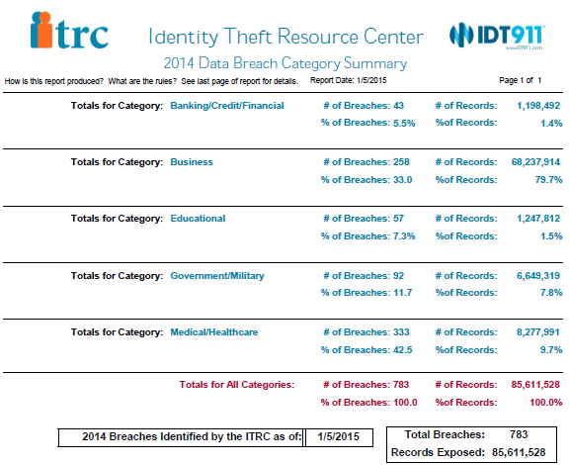
How do we use social media safely?

Slide 26
What should your lodge do to be effective? Conclusions…..
Youth and adults have different interests in Social Media. One size DOES NOT fit all!
There is no single solution that will work for both youth and adults.
Don’t bother wasting time and resources on methods that are only marginally effective in your lodge.
Establish just a few methods that work for your lodge, and make sure they are kept active, up-to-date, and relevant to the youth and adults!

Slide 27
Questions?
What is on your mind?
Thanks for coming to this presentation!

Slide 28
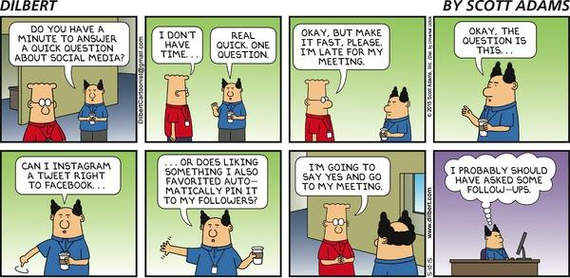
Appendix

Slide 29
BSA Social Media Guidelines
General Considerations
Any Scout units that plan to use social media should share the following Internet safety guidelines with Scouts, parents, and leaders, and all Scouts should abide by the following Internet safety guidelines and personal protection rules:
Keep online conversations with everyone in public places, not in email.
Do not give anyone online your real last name, phone numbers at home or school, your parents’ workplaces, or the name or location of your school or home address unless you have your parents’ permission first. Never give your password to anyone but a parent or other adult in your family.
If someone sends or shows you email or any type of direct message/wall post with sayings that make you feel uncomfortable, trust your instincts. You are probably right to be wary. Do not respond. Tell a parent or trusted adult what happened.
If somebody tells you to keep what’s going on between the two of you secret, tell a parent or guardian.
Be careful to whom you talk. Anyone who starts talking about subjects that make you feel uncomfortable is probably an adult posing as a kid.
Pay attention if someone tells you things that don’t fit together. If one time an online “friend” says he or she is 12, and another time says he or she is 14. That is a warning that this person is lying and may be an adult posing as a kid.
Unless you talk to a parent about it first, never talk to anybody by phone if you know that person only online. If someone asks you to call—even if it’s collect or a toll-free, 800 number—that’s a warning. That person can get your phone number this way, either from a phone bill or from caller ID.
Never agree to meet someone you have met only online at any place off-line, in the real world.
Watch out if someone online starts talking about hacking, or breaking into other people’s or companies’ computer systems; phreaking (the “ph” sounds like an “f”), the illegal use of long-distance services or cellular phones; or viruses (online programs that destroy or damage data when other people download these onto their computers).
Promise your parent or an adult family member and yourself that you will honor any rules about how much time you are allowed to spend online and what you do and where you go while you are online.

Slide 30
BSA Social Media Guidelines
GENERAL CONSIDERATIONS FOR SOCIAL MEDIA USE
For practical considerations, the BSA expects adults intending to use social media on behalf of Scouting to follow the following:
Social media must be monitored. A qualified staff member or volunteer should have the responsibility of monitoring social media channels daily, and backup administrators/monitors should be designated so there is no gap in the monitoring.
Integrate your communications. Create a strategy to surround your intended audience with your key message(s) through print, the Web, email, radio, TV, word of mouth, and social media.
Talk to your audiences and let them talk to and about you. By posting content on a consistent schedule, you can tell your story and encourage conversations in the community.
Social media takes a thick skin. Negative conversations are happening already, but now you have a voice in the conversation. Don’t delete negative comments unless they violate the terms laid out in the BSA Social Media Digital Contract.
Be prepared to respond to negative or inaccurate posts if response is warranted. Some negative comments do not require a response, while others should be taken seriously and addressed. Factors such as the number of followers and the severity of the conversations should temper if and how you respond.
Direct media inquiries to the appropriate person. Media inquiries coming through social media should be referred to the Scout executive or a designee for an official response.
Be Scout-like. When disagreeing with others’ opinions, remain appropriate and polite. If you find yourself in a situation online that looks as if it’s becoming antagonistic, do not get overly defensive and do not disengage from the conversation abruptly. Ask your Scout executive or the designee for advice on how to disengage from the dialogue in a polite manner that reflects well on the BSA.
Build trust by being open and transparent. Share information and what the challenges and opportunities are for Scouting in your community.

Slide 31
For Training Resources and More Information Visit:
http://training.oa-bsa.org/noac2015

