Slide 1
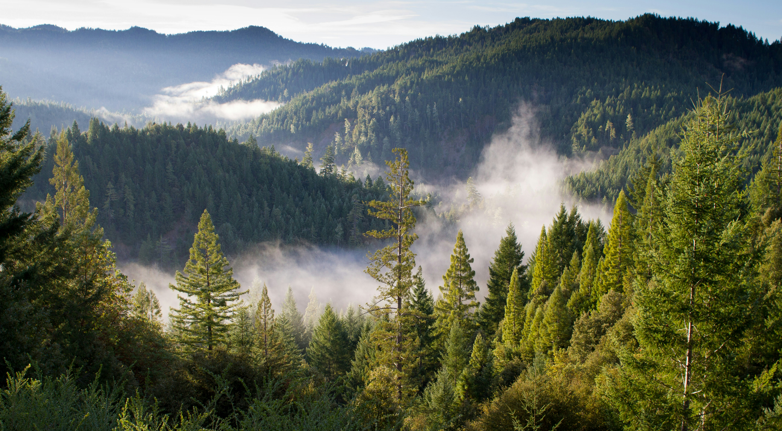

Slide 2
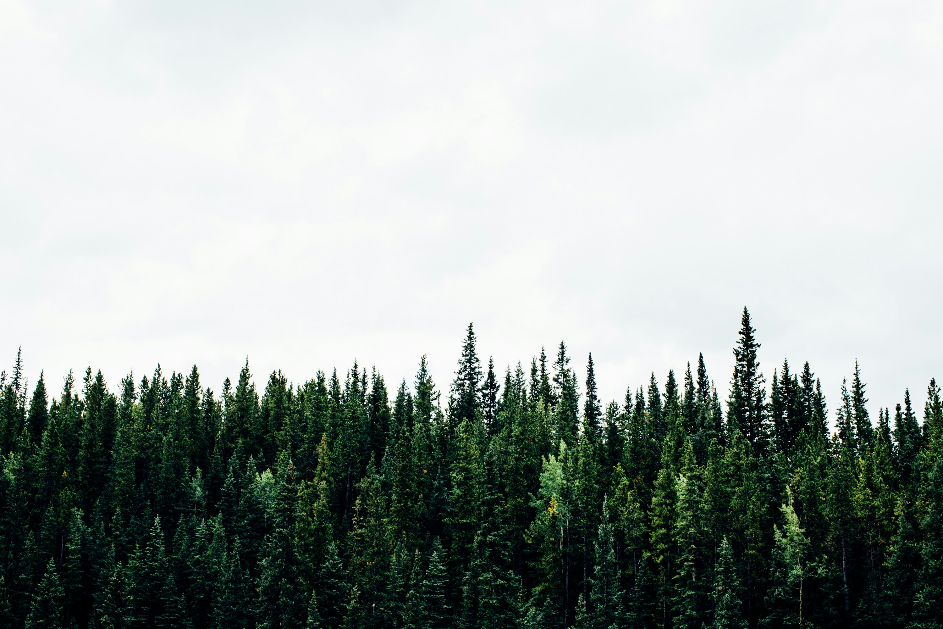
Four OA High Adventure Programs!
NORTHERN TIER
OA Wilderness Voyage
OA Canadian Odyssey
THE SUMMIT
OA Summit Experience
PHILMONT
OA Trail Crew

Slide 3
Benefits of OAHA Experiences
Lower cost for a longer trek
Work and play (pretty much at same time)
Meet Arrowmen from around country
Build the bonds of brotherhood
Get exclusive participant patches
Opportunities to meet and work with OA leadership from across the nation

Slide 4
OA Summit Experience
Takes Place at The Summit
Started in 2014
Meant as introductory OAHA Experience
Foremen are well trained. At least one of every pair is WFA trained, all have CPR and First Aid Training

Slide 5
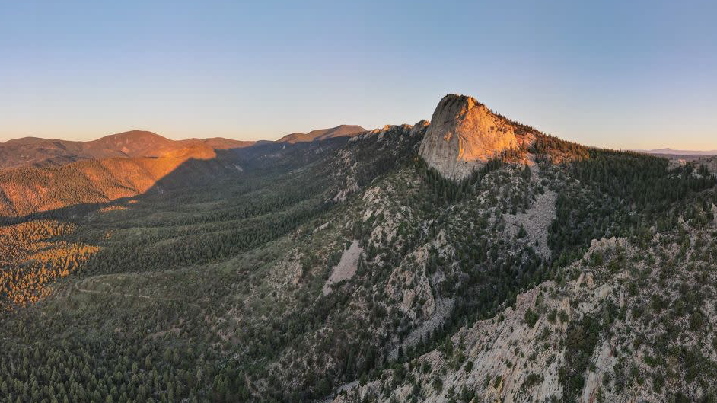
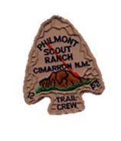
Philmont Trail Crew
Started in 1995
Primarily Backpacking Focused
OA Trek Benefits:
Get in when other crews can get blocked
Everybody at Philmont loves the OA!
Go back and see the new trail you build years later!
Led by Foremen-2 per crew, First Aid and CPR certified, highly trained

Slide 6
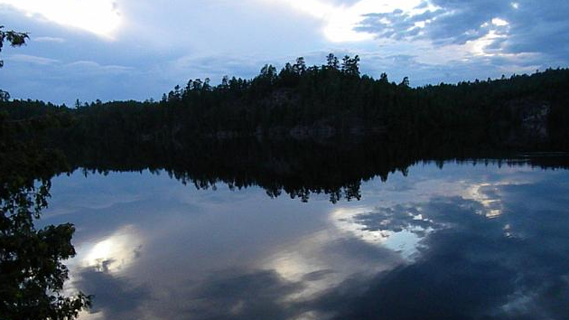
OA Wilderness Voyage The Northwoods, Land of Voyageurs
Started in 1999
Two weeks in the Wilderness
Takes place in Boundary Waters Canoe Area Wilderness, in Superior National Forest
Charles L. Sommers Canoe Base is 22 miles Northeast of Ely
Crew is led by two foremen, Eagle Scouts, Wilderness First Aid, CPR, emergency contact can be made

Slide 7
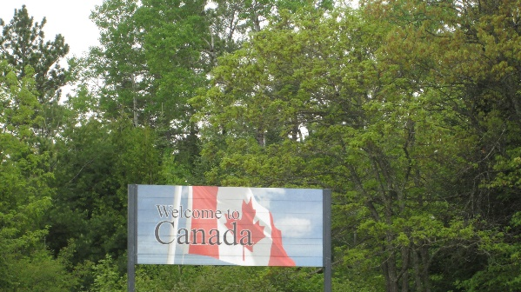
OA Canadian Odyssey Going International
Started in 2009
Start in Ely with OAWV
Takes place in Quetico Provincial Park in Ontario
Cross Border at Prairie Portage
2 Foremen Trek Leaders, Wilderness First Aid, CPR, Eagle Scouts

Slide 8
Before…

Slide 9
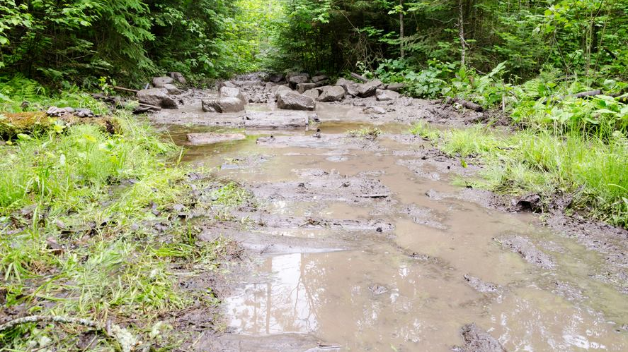
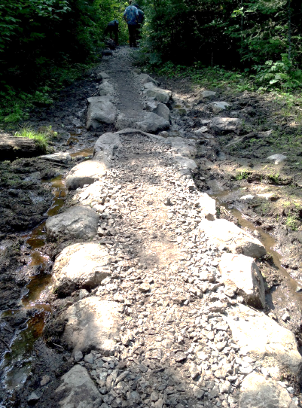
After!

Slide 10
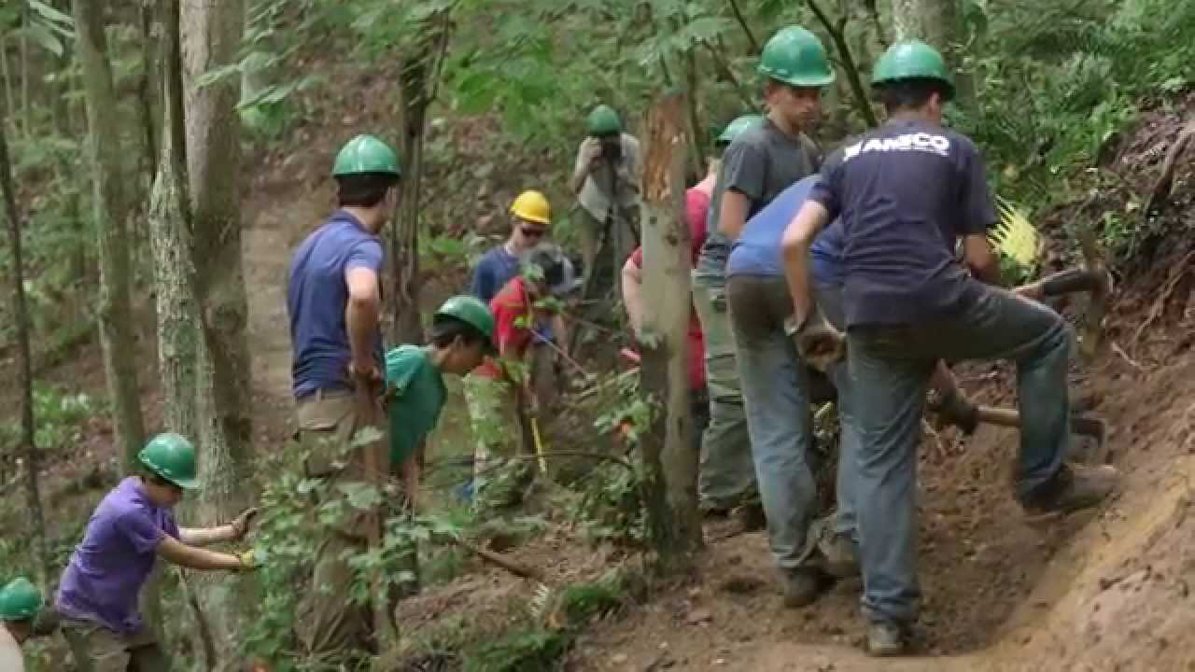
“Wilderness Voyage to me is two-fold—service and fun. Would I go back for this same experience again? Absolutely! Wilderness Voyage has taught me a lot about myself and even helped me to understand who I am just a little bit better. I am forever a changed young man for participating.”

Slide 11
Program Details
Program | High Adventure Base | Length | Age Range | Cost
OA Trail Crew | Philmont Scout Ranch | 14 days | 16-20 years old | Check the website for the latest information!
OA Wilderness Voyage | Northern Tier | 14 days | 16-20 years old
OA Canadian Odyssey | Northern Tier | 14 days | 16-20 years old
OA Summit Experience | Summit Bechtel Reserve | 7 days | 14-17 years old

Slide 12
How to Sign Up!
Go to https://oa-bsa.org/oaha
Option 1) Print the application, fill it out, and then mail it with deposit or full fee to the address on the application
Option 2) Register and pay online
$50 Non-Refundable Deposit is required when submitting the application
Can pay full fee at that time (full payment due within 60 days of acceptance)
Get Lodge Adviser and Scout Executive/Lodge Staff Adviser Permission (email approval is acceptable)

Slide 13
Thank You For Coming!

